Slide 1
Partial breast reconstruction of 30 cases with peri-mammary artery perforator flaps
HOD – PROF Dr. J.A. JAYALAL M.S., FRCS ., PH.D
UNIT CHIEF – Dr. ANGELINE VINCENT M.S D.G.O
ASSISTANT PROFESSORS – Dr. Arulkumar M.S
Dr. Mohammed Rafeek M.S
REVIEW BY Dr R..AMALA
FIRST YEAR POST GRADUATE
DEPARTMENT OF GENERAL SURGERY

Slide 2
Background
Volume replacement is one of the vital techniques of oncoplastic surgery (OPS) when applying breast conserving surgery.
The clinical application of peri-mammary artery perforator flaps for this indication is uneven in China.
Here, we describe the results of our clinical experience with peri-mammary artery faps for partial breast reconstruction.

Slide 3
Methods
In this study, 30 patients underwent partial breast resection for quadrant breast cancer followed by partial breast reconstruction with peri-mammary artery perforator flaps, which included the thoracodorsal artery perforator flap (TDAP), anterior intercostal artery perforator flap (AICAP), lateral intercostal artery perforator flap (LICAP), and lateral thoracic artery perforator flap (LTAP).
All the patients operation plans were discussed comprehensively and were performed by sticking to every step.
The satisfaction outcome was assessed with the extracted version of the BREAST-Q version 2.0, Breast Conserving Therapy Module Preoperative and Postoperative Scales both preoperatively and postoperatively.

Slide 5
Results
According to the study outcomes, the mean flap size was 5.3*4.2*2.8 cm . The mean surgical time was 142 min (100–250 min).
No partial flap failure was detected, and no severe complications were observed.
Most patients were satisfied with the outcomes regarding the dressing, sexual life, and breast shape post operation.
Furthermore, the sensation of the surgical area, scar satisfaction, and recovery state gradually improved.
Overall, LICAP and AICAP had higher scores when different flaps were compared.

Slide 6
Conclusion
Based on this study, we found that peri-mammary artery flaps had significant value in breast-conserving surgery, especially in patients with small or medium-sized breasts.
Perforators could be detected by vascular ultrasound before the operation. More than one perforator could be found most of the time.
No severe complications occurred when performing a suitable plan, including discussing and recording the operation procedure; the focus of care, the choice for precise and proper perforators, and the mechanism for hiding the scars were all considered and recorded in a specific chart.
Patients were satisfied with the reconstruction technique of peri-mammary artery perforator flaps after breast-conserving, and the satisfaction of AICAP and LICAP was higher.

Slide 7
Introduction
Breast-conserving surgery has become the standard treatment for early-stage breast cancer.
Breast preservation surgery and radiotherapy have the same local recurrence and survival rates as total breast resection .
However, routine breast preservation surgery will result in postoperative local depression, poor breast appearance.
Oncoplastic breast conserving surgery (OBCS) combines surgical oncology and plastic surgery techniques.
Applying this technique is considered to increase the chances of breast conservation and reduce the rate of positive margins and the proportion of surgical reresection, improving the appearance of the breast at the same time .
The OBCS technique is mainly divided into volume displacement and volume replacement.

Slide 8
When breast preservation defects reach more than 20% of the breast, solely relying on volume displacement will often result in a poor appearance.
Volume replacement is required for a certain proportion of breast volume defects or with a particular tumour location .
Currently, most specialized breast centres are mature in using the latissimus dorsi flap or lateral adipofascia flap for volume replacement in China.
However, the need to sacrifIce part or all of the latissimus dorsi muscle or the range of movement after fascia flap acquisition is minimal.

Slide 9
Method
From January 2021 to March 2022, the Breast Department of Maoming People’s Hospital, Guangdong Province, completed partial breast reconstructions after breast conservation surgery with lateral chest wall fascia faps, which were performed by the same surgeon. The surgical methods and postoperative results of the 30 patients were summarized and analysed.

Slide 10
All cases of invasive ductal carcinoma were diagnosed by preoperative crude needle biopsy, the tumour diameter was 1.5 to 4.2 cm, and 10 patients underwent neoadjuvant chemotherapy.
The postoperative tumour stages were as follows: 6 in stage I, 15 in stage IIA, 8 in stage II B, and 2 in stage IIIA.
The average resection area was 4.5*3.4*2.6 cm .
The tumours were located as follows: external quadrant (20 cases) and internal quadrant (10 cases).
Lateral thoracic and abdominal perforator flaps, such as the anterior intercostal artery perforator fap (AICAP), lateral intercostal artery perforator fap (LICAP), thoracodorsal artery perforator fap (TDAP), or lateral thoracic artery perforator fap (LTAP), were applied for every site with a defect.

Slide 11
When the tumour was located in the lateral breast (outer upper or outer lower quadrant), the lateral chest wall flap, thoracic dorsal artery perforator flap, or the intercostal artery side could be used.
When the tumour was located at the lower pole or upper part of the breast, the intercostal artery anterior perforator flap or the fascia tissue flap above the rectus abdominis could be used.
All patients signed an informed consent form before surgery after being informed of the surgical risks. Patient satisfaction was assessed at one month, three months, and six months after surgery.

Slide 12
Preoperative preparation
For all patients, a preoperative discussion was performed among the operation group, and these discussions included discussing nursing requirements for preoperative preparation (physical and psychological preparation, including skin preparation in the surgical area).
Confirmed implementation process of preoperative vascular positioning: Colour Doppler ultrasound physicians should have accepted positioning training on the vascular pedicles of the chest wall in advance. Colour Doppler was routinely applied to label the main vessels of the flap by ultrasound.

Slide 13
The operating surgeon drew the estimated resection range and the possible repair plan. The thickness of the flap was also estimated by the pinch test and was the approximate estimate of the effect of the flap filling back to the defect.
The surgical body position was confirmed during the operation, and the instrument nurse was informed to prepare a vascular identification band. The postoperative nursing requirements were formulated (including monitoring of the fap blood circulation in both the arteries and veins, observation of the drainage tube, and requirements for dressing or wearing chest tightness).
The following data were routinely recorded before surgery: breast size, tumour size, location, and estimated defect volume.

Slide 14
Operation implementation process
The incision selection depended on the location of the mass and the possible location of the flap before surgery. Properly para-areola, lateral chest wall (which can be covered by a bra), or inframammary fold wall could be considered.
Completed conventional breast conservation resection: Based on the principle of tumour safety, the tumour with tissue edges more than 1 cm in large lesions was removed, and 4–6 margins were cut in the upper, lower, inner, and external directions.
Sentinel node biopsy or conventional lymph node dissection was implemented, and the skin covering the tumour was removed at the same time if necessary.

Slide 15
The flap should be designed in a specific position (supine or lateral position, arm abduction, raised with small sterile pads outside the chest and underarms), adapting to the location of potential perforators.
If no perforators were found before surgery, more small perforators could usually be found during donor area exploration.
Peri-mammary artery perforator flaps could cover the repair of different quadrant defects.
However, in the actual election of the perforator flap, the closest pedicle to the breast defect would always be applied so that the flap had enough mobility to transfer and fill the breast defect.

Slide 16
When separating the flap, it was necessary to follow the dermatoglyphics away from the main perforator vessel of the fap and adopt a wedge resection method to separate the fat.
The subcutaneous capillary network in the fascial tissue should be retained as much as possible, and more adipose tissue should be obtained to meet the filling needs.
It was always necessary to use a blood vessel identification belt to pay attention to the protection of the pedicle vessels.
When grabbing the flap, attention should also be paid to the length and width ratio. As long as the perforating vessel blood supply is excellent, the length and width ratio can appropriately exceed 3:1

Slide 17
Application of a TDAP (Thoracodorsal artery perforator flap):
If the thoracodorsal flap perforator was chosen, the
Anterior boundary - lateral margin of the pectoralis major muscle
Posterior boundary - anterior edge of the latissimus dorsi muscle
Upper boundary - thoracodorsal vessel bifurcation of the axillary vessels
The lower boundary - umbilical level due to suffcient bare perforations of the thoracic dorsal artery branch
This flap could be designed to have a more extensive range of motion than other regional flaps.
Therefore, it could be used for defects in various quadrant areas of the breast.
Of course, in the actual implementation process, if the local area flap could meet the requirements, there was no need to use this flap.
It was also selected according to the different factors considered by each surgeon or the actual situation during the operation

Slide 19
Application of an AICAP (Anterior intercostal artery perforator flap)
If the defect was located in the lower or inner upper quadrant, the anterior intercostal artery perforator flap could be chosen, the upper side was the inframammary fold, and an appropriate width should be considered according to the size of the defect.
In the process of obtaining the flap, the adipofascia tissue above the rectus abdominis muscle could be simultaneously obtained as much as possible, and part of the rectus abdominis sheath tissue could be carried at the same time to stabilize the flap blood supply.
The dermal fascia flap with the removed epidermis could be used to further reduce the possibility of fat liquefaction or necrosis of the postoperative tissue flap

Slide 21
Application of the LICAP (lateral intercostal artery perforator flap)
When the defect was in the outer lower quadrant, the outer upper quadrant, or the central area, a lateral intercostal artery perforator flap was designed.
According to the results of nearly 200 autopsy cases performed by Hamdi et al., the perforators are located approximately between the 3rd–8th intercostal space. The more concentrated ones are between the fifth and seventh ribs within approximately 2.5–3.5 cm from the anterior edge of the anterior serratus muscle . In addition to conventional empirical body surface localization, vascular colour ultrasound was used to clarify the actual location of the puncture branch before the operation. l

Slide 22
The upper boundary - subthoracic and dorsal vascular bifurcation of the axillary vessels
lower boundary -could be reached below the inframammary fold
the anterior boundary - lateral margin of the pectoralis major muscle
the posterior boundary - anterior edge of the latissimus dorsi

Slide 24
Application of the LTAP (lateral thoracic artery perforator flap):
When the defect is located on the lateral side of the breast, and if the subcutaneous tissue of the lateral chest wall is relatively plump, perforators in the lateral chest wall near the armpit can be located before surgery , and the flap might include the lateral thoracic artery (lateral thoracic branch), intercostal artery and serratus anterior branch of the dorsal thoracic artery. There is no need to expose all perforators during manipulation, and attention must be paid to retaining the vascular plexus of the fascia flap, including the subfascial, middle, and upper vascular networks. A rough tissue flap area was marked according to the defect size during the operation. It was recommended to use a sharp scalpel to detach the fascia. The tissue flap should contain the subcutaneous vascular network and superficial and deep fascia with no skin.

Slide 25
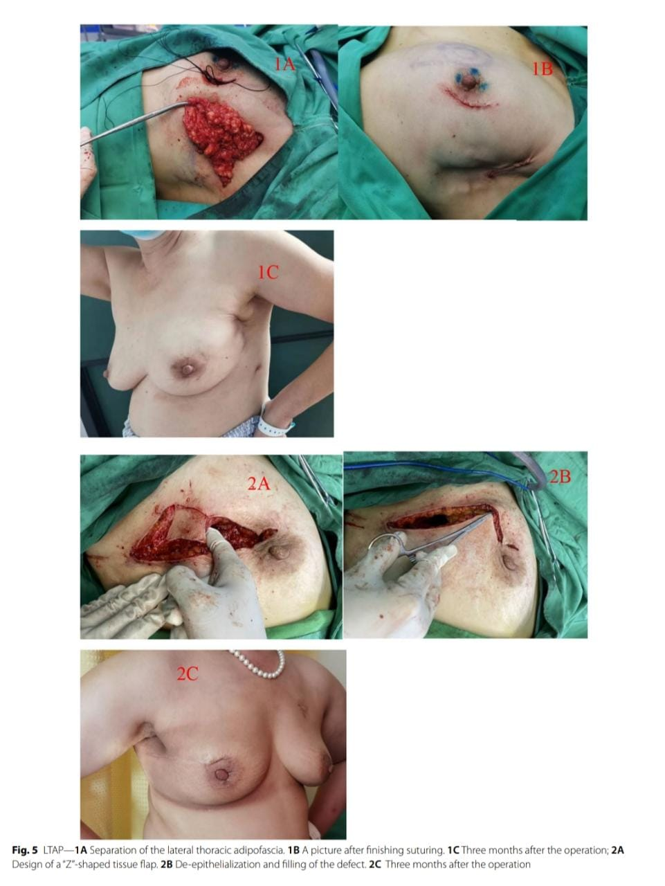

Slide 26
Cosmetic evaluation
To assess patient satisfaction with the general and aesthetic outcomes of the oncological surgery, we used the extracted version of the BREAST-Q version 2.0, Breast Conserving Therapy Module Preoperative and Postoperative Scales to form a new breast reconstruction satisfaction questionnaire, which was administered at one month, three months, and six months after surgery.
Each question was scored on a 5-point scale, ranging from "very satisfied " to "not satisfied " .

Slide 27
We also compared patients satisfaction with different flaps. SPSS 21.0 statistical software was used for the statistical analysis of the data.
The chi-square test was used to compare the differences between the groups.
All statistical data were statistically significant at P<0.05.

Slide 28
Results
A total of 30 patients received volume replacement techniques from 2021 to 2022 after BCS .
The mean age was 54 years (33–65 years), and the mean follow-up interval was 9.3 months (3–17 months).
A preoperative search for vascular perforations in all cases was performed by Doppler ultrasound.
In the first patient, the vascular perforations were attempted to be sought out through CTA.
However, it was difficult to accurately complete the identification of the finer perforators both in CTA and body surface positioning

Slide 29
Given the increased cost of the inspection and the problem of radiological damage, in the operation group, CTA was abandoned for localization.
Vascular colour ultrasound identification proceeded routinely in all subsequent patients.
Mostly, the required perforators could be found.
If perforators were unable to be found or if other unplanned available perforators were found, adjusting the original plastic surgery strategy could be managed.
It is more challenging to find braces for AICAP because they are all thinner perforators.

Slide 30
Therefore, careful fascial sharp separation from far to near should be implemented.
It was important to protect every tiny perforator before deciding the superior perforator when the blood supply situation of the flap was clear.
In the search process of each vascular perforator, if a microscope or a head-wear microscope could be utilized, the efficiency of perforator finding could be improved, and the quality of perforator blood transport could be guaranteed.

Slide 31
Usually, one or more perforators can be found and used per flap, but it is not recommended to use them all because they will potentially affect flap rotation.
The average surgical time (including tumour resection and reconstruction) was 142 min (100–250 min).
The time to flap cutting, peeling, and remodelling averaged 45 min (30–60 min).

Slide 32
In three cases, a TDAP was applied to repair tumour defects in the lateral or inner upper quadrant,
LICAP flaps were applied in nine cases to repair the lateral or central breast area,
an AICAP was applied in eleven cases for the lower or inner upper quadrant,
lateral tissue flaps adipofascia with skin de-epithelialization or just separation of subcutaneous tissue with no skin was applied in seven cases.

Slide 33
No wound infection occurred, but one AICAP flap developed fat necrosis, which recovered after local treatment with conventional suction flow. Local tissue stiffness in the area was left in the short term in the following half year, but the situation gradually decreased after breast shaping and active fat hypertrophy.
One patient with an LICAP developed venous congestion on the first day after surgery.

Slide 34
In addition, the simultaneous placement of the drain was located mainly at the bottom of the flap, the flap was located below the nipple-areola, and the effusion below the nipple-areola failed to drain smoothly. The increased effusion further aggravated the flap tension. However, after specific monitoring by the nursing team and the improvement of the increased flap tension caused above, the venous congestion gradually improved, and the flap blood circulation returned to normal 4–5 days after surgery.

Slide 40
Conclusion
All in all, patients were satisfied with the reconstruction technique of peri-mammary artery perforator flaps after breast-conserving according to this study, and the satisfaction of AICAP and LICAP was higher, this technique is suitable for partial breast reconstruction in A-cup or B-cup breasts, and it does not appear to negatively impact patient satisfaction.
There is a great chance for knowledge exchange in the centre, which can cause a revolution of knowledge

Slide 41
References
1. Veiga DF, Veiga-Filho J, Ribeiro LM, Archangelo I Jr, Balbino PF, Caetano LV, Novo NF, Ferreira LM. Quality-of-life and self-esteem outcomes after oncoplastic breast-conserving surgery. Blast Reconstr Surg. 2010;125(3):811–7. doi: https://doi.org/10.1097/PRS.0b013e3181ccdac5. Retraction in: J Cancer Res Ther. 2019;15(1):264
. 2. Veronesi U, Saccozzi R, Del Vecchio M, Banf A, Clemente C, De Lena M, Gallus G, Greco M, Luini A, Marubini E, Muscolino G, Rilke F, Salvadori B, Zecchini A, Zucali R. Comparing radical mastectomy with quadrantectomy, axillary dissection, and radiotherapy in patients with small cancers of the breast. N Engl J Med. 1981;305(1):6–11. https://doi.org/10.1056/ NEJM198107023050102.
3. Clough KB, Cuminet J, Fitoussi A, Nos C, Mosseri V. Cosmetic sequelae after conservative treatment for breast cancer: classifcation and results of surgical correction. Ann Plast Surg. 1998;41(5):471–81. https://doi.org/10. 1097/00000637-199811000-00004.
4. D’Aniello C, Grimaldi L, Barbato A, Bosi B, Carli A. Cosmetic results in 242 patients treated by conservative surgery for breast cancer. Scand J Plast Reconstr Surg Hand Surg. 1999;33(4):419–22. https://doi.org/10.1080/ 02844319950159136.
5. Slavin SA, Halperin T. Reconstruction of the breast conservation deformity. Semin Plast Surg. 2004;18(2):89–96. https://doi.org/10. 1055/s-2004-829043.
6. Association of Breast Surgery at BASO; Association of Breast Surgery at BAPRAS; Training Interface Group in Breast Surgery, Baildam A, Bishop H, Boland G, Dalglish M, Davies L, Fatah F, Gooch H, Harcourt D, Martin L, Rainsbury D, Rayter Z, Sheppard C, Smith J, Weiler-Mithof E, Winstanley J, Church J. Oncoplastic breast surgery—a guide to good practice. Eur J Surg Oncol. 2007 Aug;33 Suppl 1:S1–23. doi: https://doi.org/10.1016/j. ejso.2007.04.014. Erratum in: Eur J Surg Oncol. 2008 Jun;34(6):II. Church, Jacqueline [added].
7. Campbell EJ, Romics L. Oncological safety and cosmetic outcomes in oncoplastic breast conservation surgery, a review of the best level of evidence literature. Breast Cancer (Dove Med Press). 2017;4(9):521–30. https://doi.org/10.2147/BCTT.S113742. 8. TaglialatelaScafati S, Cavaliere A, D’Andrea

Slide 42
Received: 21 September 2022
Accepted: 10 February 2023
Published online on 21 feb 2023

