Slide 1
Preaponeurotic endoscopic repair (REPA) of diastasis recti associated or not to midline hernias
Unit chief- Dr Angeline Vincent MS DGO
Assistant professors
Dr. S. Yuvaraj MS DA
Dr. Arul Kumar MS
Journal club presentation
Dr. Aswathy Pt
Post Graduate
Dept of General surgery
Kanyakamari government medical college

Slide 2
Preaponeurotic endoscopic repair (REPA) of diastasis recti associated or not to midline hernias
Author
Derlin marcio Juarez Muas
Hospital Publico Materno Infentil, 1301 Sarmiento Ave, Salta 4400, Argentina
Surgical endoscopy (2019) 33:1777-1782

Slide 3
Objective
To evaluate the result of Preaponeurotic endoscopic repair (REPA) of diastasis recti associated or not to midline hernias

Slide 4
Design
Prospective study

Slide 5
Materials and methods
April 2014 and July 2017
50 patients underwent surgery
94% female between 24 and 66 years (38)
Pain and/or epigastric and/or umbilical tumor
Ultrasonography

Slide 6
Location of diastasis
Epigastric 50%
Epigastric umbilical 26%
Epigastric umbilical infra umbilical 24%
Diastasis recti was associated with midline defects in 100% cases

Slide 7
Patient selection
Inclusion criteria
Patients with diastasis of recti > 3cm, associated or not with a hernia of the midline
Symptomatic patients with midline defects associated with diastasis
Have indication of the abdominoplasty but reject it

Slide 8
Excluded
Diastasis of the recti with diastasis of the skin flap
Extreme laxity of the abdominal wall ( defeated abdomen)

Slide 9
Surgical technique
Under GA
Dorsal decubitus with separated legs
10 mm incision suprapubic midline
Preaponeurotic space created
8 and 10 mmHg
5mm working trocars in both iliac fossa

Slide 10
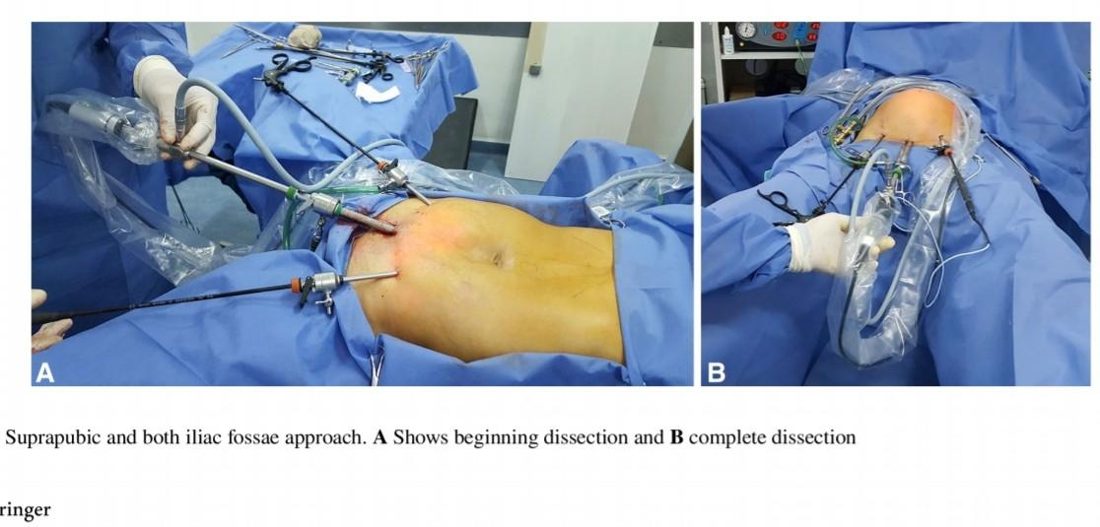

Slide 11
Subcutaneous tissue completed up to 3 cm beyond bilateral costal margins
Laterally to the anterior axillary lines
Control of periumbilical perforating vessels and haemostasis with monopolar hook
Navel disinserted
Plication of the rectus sheath with barbed suture is performed from the xiphoid appendix to 5cm subumbilical

Slide 12
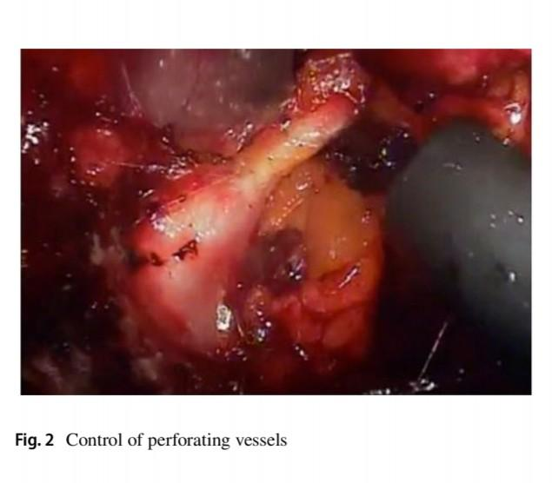

Slide 13
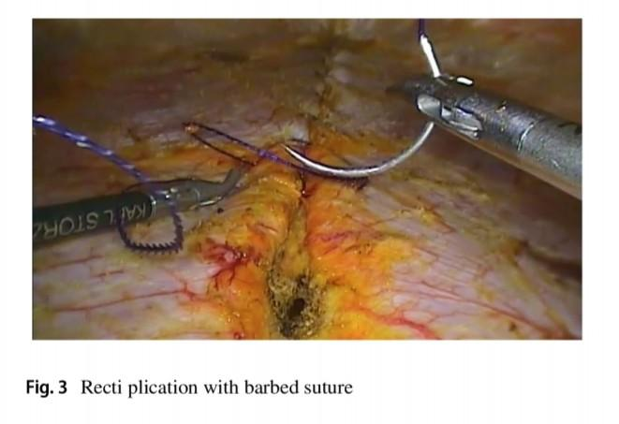

Slide 14
Release of the external oblique aponeurosis is made outside the outer edge of the rectus
The diastasis exceeds 7cm
To perform suture of the midline without tension
After repair of midline defect, new cavity is washed with saline to remove fat, devitalised tissue and clots

Slide 15
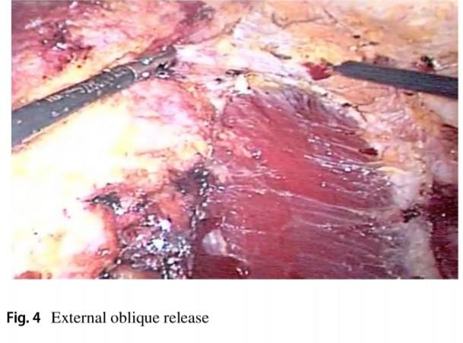

Slide 16
Macroporous polypropylene mesh
22cm x 15cm
Cover the area of the external oblique release
Prosthesis is fixed
Naval was reinserted with internal or external sutures
Suction drain

Slide 17
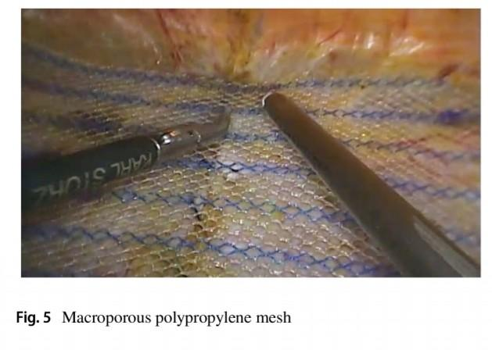

Slide 18
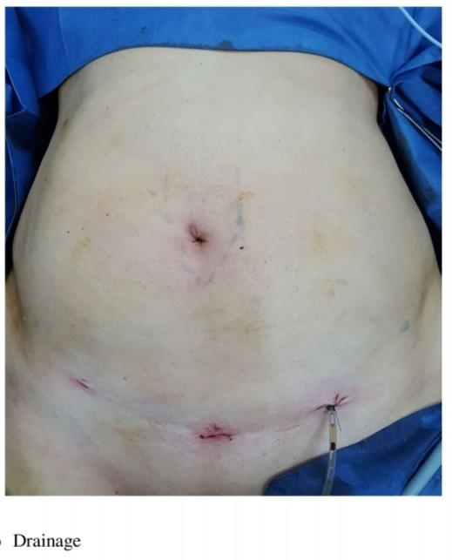

Slide 19
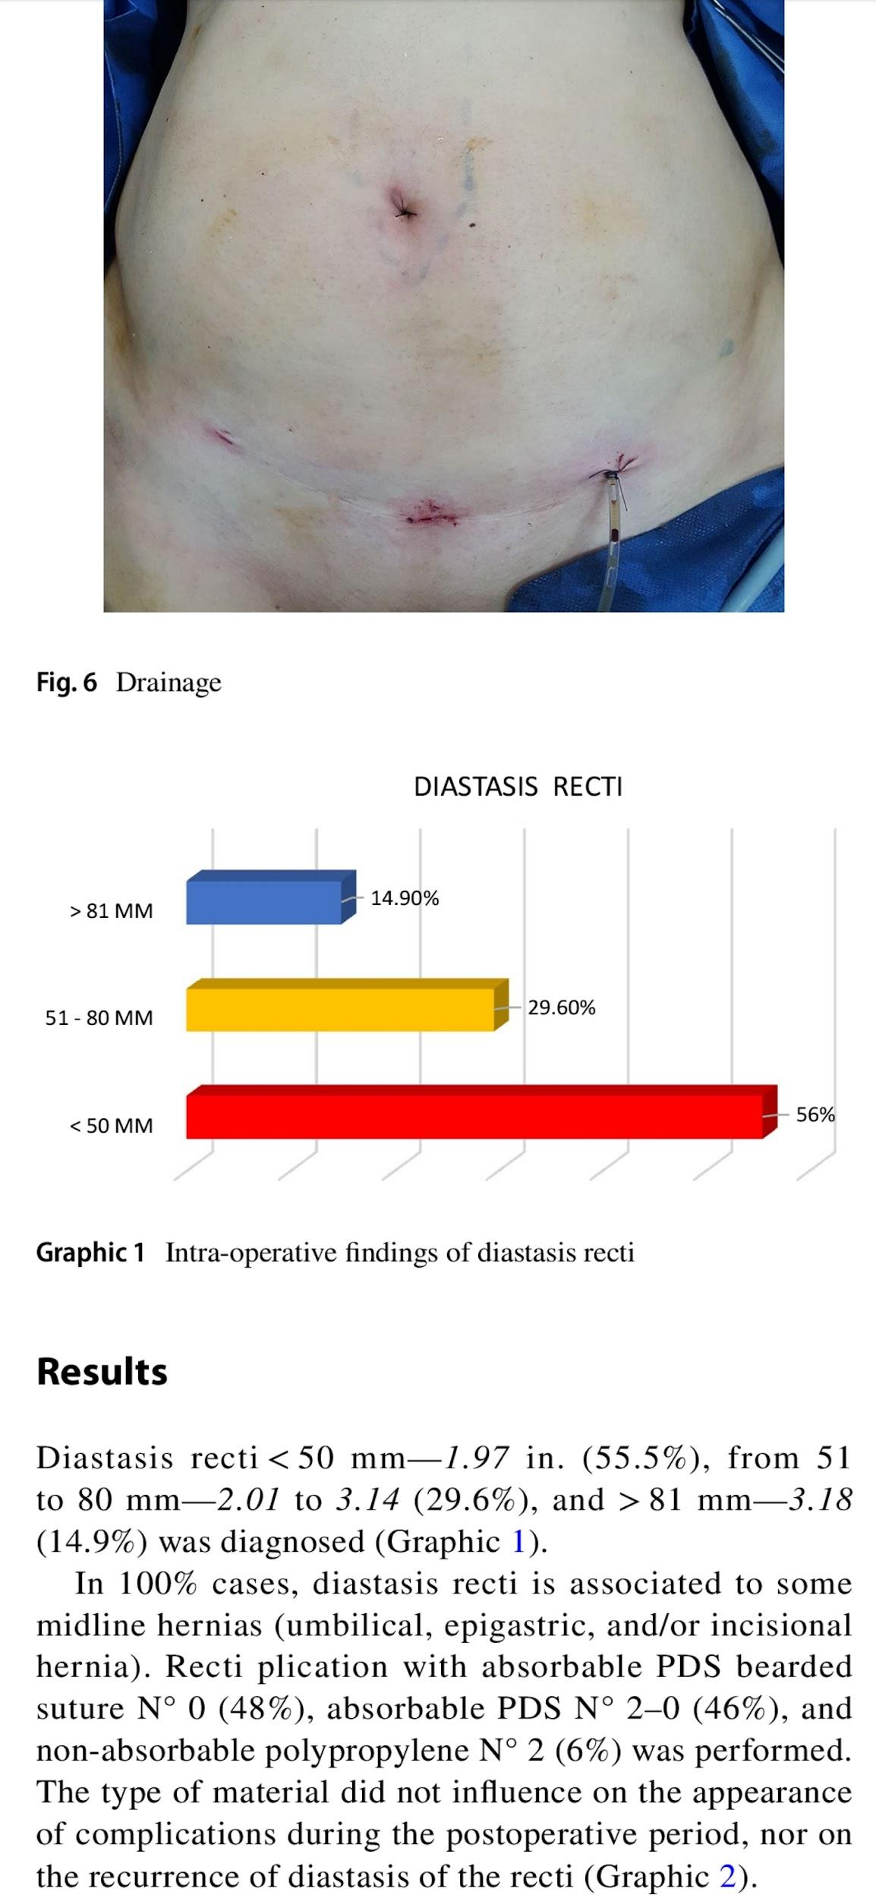
Results

Slide 20
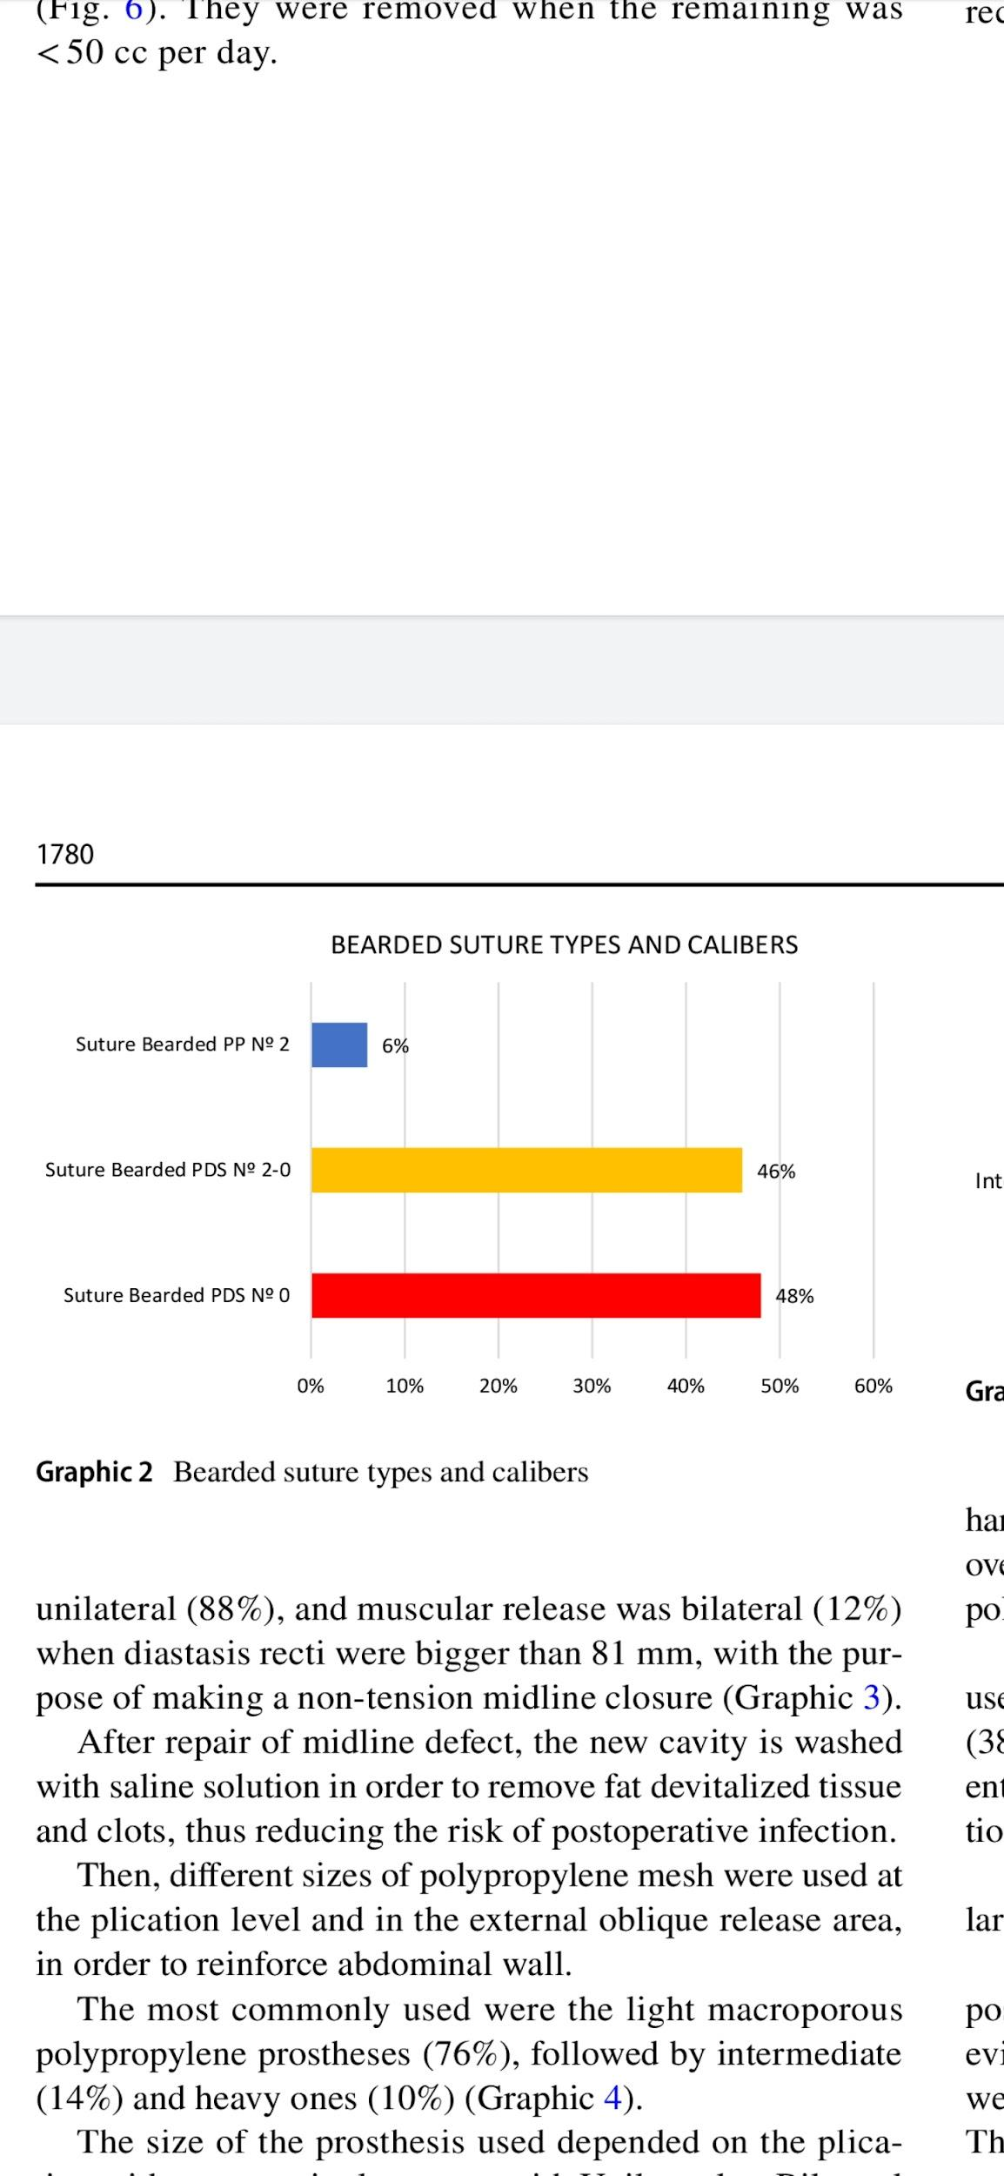

Slide 21
The type of the material did not influence
Appearance of complications in the postoperative period
Recurrence of diastasis

Slide 22
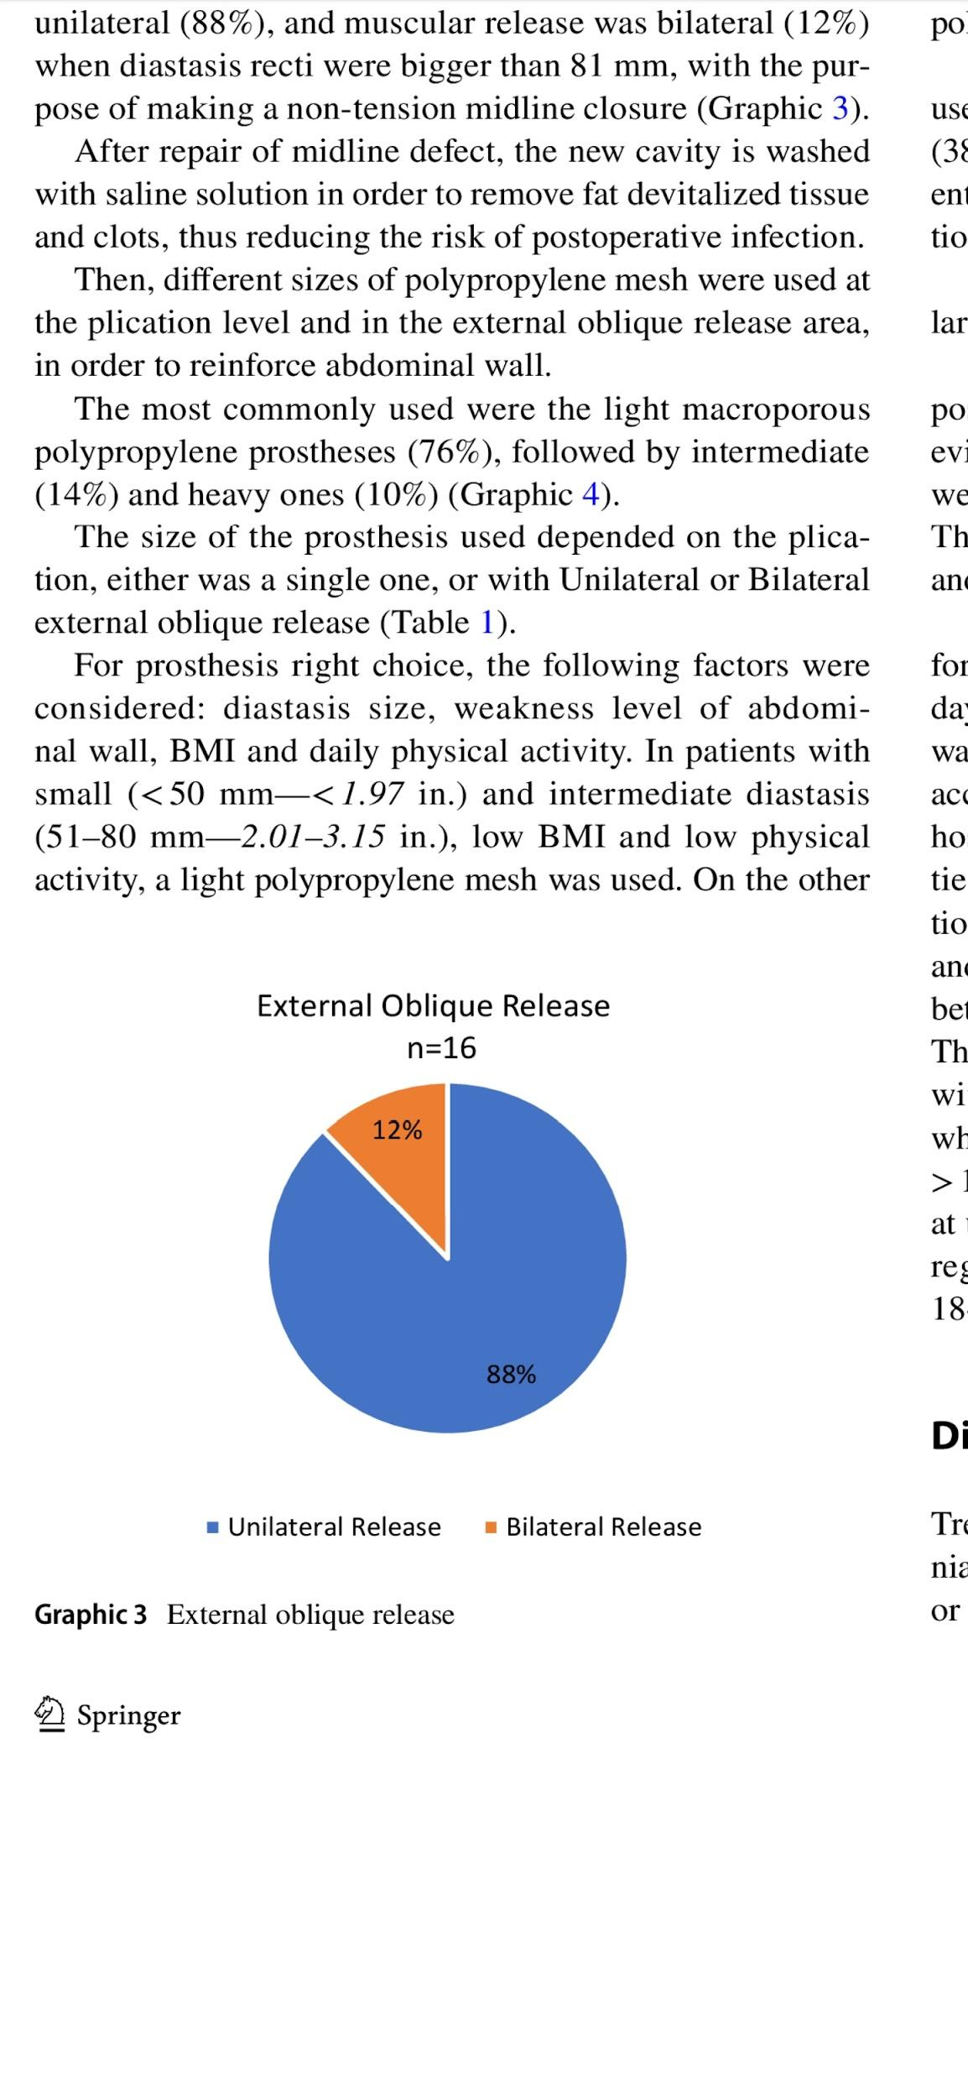

Slide 23
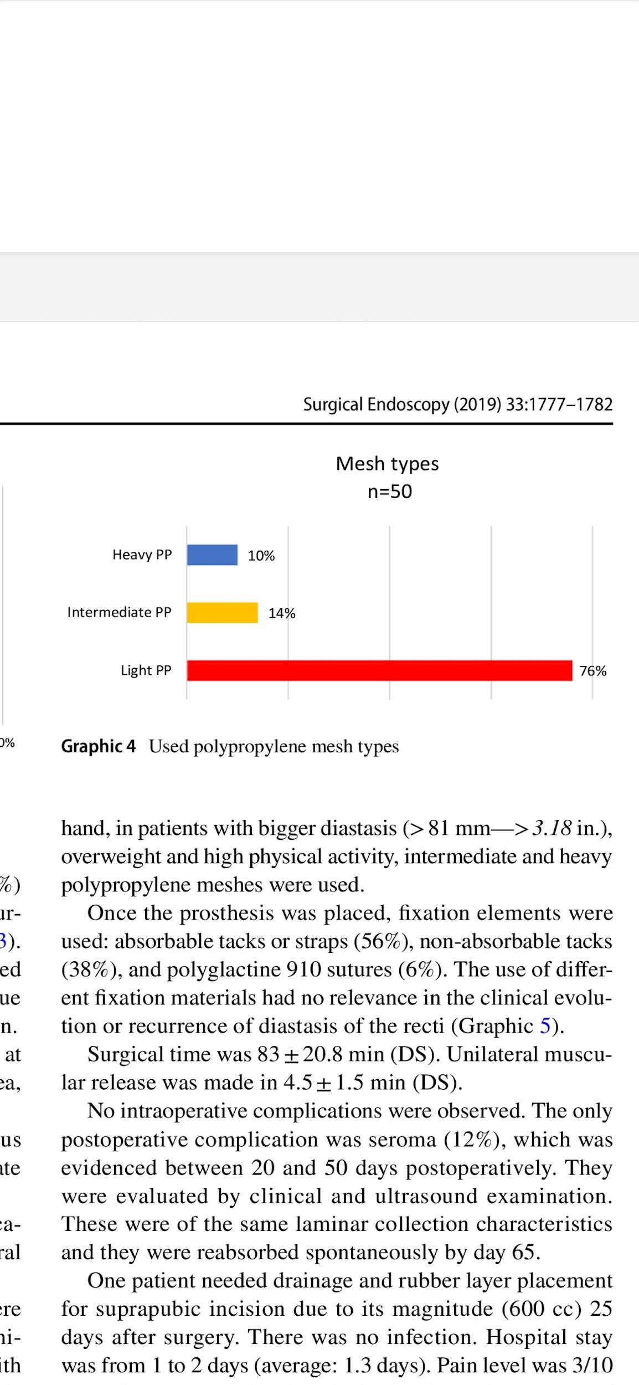
Mesh type

Slide 24
Diastasis size
Weakness level of abdominal Wall
BMI
Physical activity

Slide 25
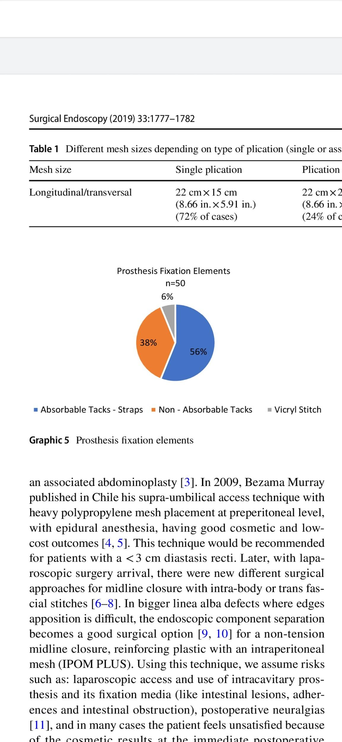
Prosthesis fixation elements

Slide 26
Use of different fixation material had no relevance in clinical evolution or recurrence

Slide 27
Surgical time was 83 +- 20.8 minutes
unilateral muscular release 45+/- 15 minutes
No intraoperative complications were observed
Only postoperative complication was seroma, 20 and 50 days
Clinical and ultrasound examination
Reabsorbed spontaneously by day 65

Slide 28
One patient needed drainage and rubber layer placement for suprapubic incision due to its magnitude 25 days after surgery
No post operative infection
Hospital stay 1-2 days (1.3)
Pain level was 3/10 (VAS)
Patient turned to his usual activities 16.4 +/-5.1 days

Slide 29
Post operative follow up was between 6 and 39 months ( 23)
No complications or recurrence at 18 months were observed by clinical and ultrasound control in 74% of the patients
Patient satisfaction was reported as 96% regarding cosmetic outcomes and postoperative pain at 18 month follow up

Slide 30
Conclusion
Endoscopic surgery allowed to resolve the parietal defect with plication of recti and placement of preaponeurotic reinforcement prosthesis, increasing the safety of the repair, without entering the abdominal cavity, with a short hospitalization and no complications or recurrence in 3 years.

Slide 31
Discussion

Slide 32
DRAM and Treatment options
Diastasis of the rectus abdominis muscles
Currently, there is no consensus on the preferred surgical management of DRAM.
DRAM repair is challenging for most general surgeons since guidelines on indication and methods for repair do not exist
A thorough literature review comparing different surgical techniques for DRAM is noticeably absent in general surgery

Slide 33
DRAM and Treatment options
Abdominal muscles are separated by an abnormal distance due to widening of the linea alba, which causes the abdominal content to bulge.
Inter-rectus distance (IRD) of 22 mm, three centimetres above the umbilicus measured in a relaxed state
Can be congenital
Most commonly acquired during pregnancies and/or larger weight gain causing laxity of linea alba

Slide 34
Pain and discomfort in the abdomen, musculoskeletal problems like pelvic instability and lumbar back pain
urinary incontinence, fecal incontinence, and pelvic organ prolapse
DRAM repair is challenging for most general surgeons since guidelines on indication and methods for repair do not exist.

Slide 35
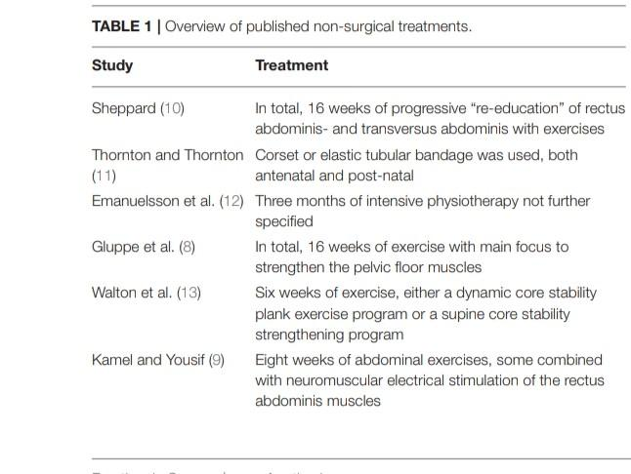
PHYSIOTHERAPY
The success rate is questionable

Slide 36
SURGICAL TREATMENT
Surgery can be considered when physiotherapy fails
Surgical options include open, laparoscopic, hybrid and robot assisted surgery.

Slide 37
Open Surgery
The success rate is overall high as most studies report a 0% recurrence rate 6 months after open surgery
classic abdominoplasty
Transverse suprapubic incision extended laterally to the anterior iliac crests to visualize the rectus muscles and the linea alba
Midline supraumbilical incision,left suprapubic incision, midline central incision, extending from the xiphiod process to the pubic area

Slide 38
Plication can be done with or without mesh reinforcement. Mesh is often used when a coexisting hernia is present
Single or double layer, interrupted or continuous
the low recurrence rates
The plication techniques can leave a surplus of skin directly after surgery

Slide 39
Modified hernia repair techniques
Modified Chevrel technique
The anterior rectus fascia is incised and overturned to form a wider new posterior rectus fascia.
The modified technique leaves the musculofascial continuity of the ventral abdominal wall intact as the abdominal cavity or the posterior rectus fascia is not opened.

Slide 40
Meshless modification of the Rives–Stoppa repair in which the hernia sac is excised and the posterior rectus fascia is sutured using an overlapping plasty. The anterior rectus fascia is then closed
Though alignment of the rectus muscles could be easier.
Recurrence is very less
If the midline is incised and the continuity is disturbed, the risk of incisional hernia formation and subsequent risk of strangulation is highly

Slide 41
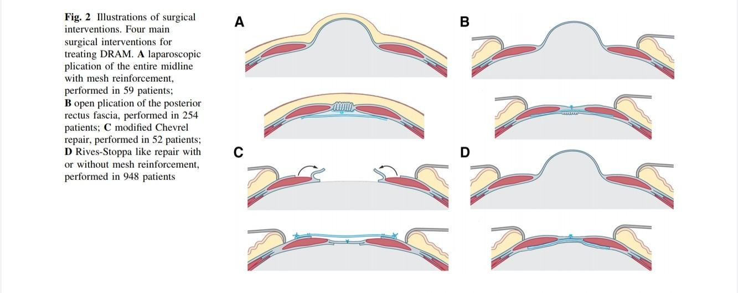

Slide 42
Laparoscopic Surgery
laparoscopic technique is commonly used when diastasis and ventral hernia coexists but can also be used for treatment of abdominal rectus diastasis solely
REPA
IPOM
IPOM Plus
TEP
LIRA

Slide 43
REPA
Endoscopic separation of the subcutaneous tissue from anterior sheaths of recti muscles reconstruction of the linea alba by preaponeurotic suturing of edges of stretched recti muscles and placement of a flat, macroporous, synthetic mesh in the subcutaneous space with subcutaneous drainage
IPOM
Placing an anti-adhesive synthetic mesh intraperitoneally around the hernia defect with peripheral fixation to the abdominal wall with sutures or staples

Slide 44
IPOM-plus
As in the IPOM technique, with additional suturing of the hernia defect, to support the mesh in place of the original defect
LIRA
Cutting posterior sheaths of recti muscles over their entire length and recreating the linea alba by their laparoscopic suturing together the fascial defect over exposed recti muscles is covered intraperitoneally with anti-adhesive synthetic mesh

Slide 45
Hybrid techniques
ELAR
Cutting anterior sheaths of the recti muscles over their entire length and recreating the linea alba by suturing them together the fascial defect over exposed recti muscles is covered with synthetic mesh
eMILOS
Incision with a length not exceeding ¼ of the diameter of implanted mesh, directly above the hernia defect dissection of the retromuscular space takes place from the hernia defect peripherally with cutting posterior sheaths of recti muscles
similarly to the MILOS method, but in order to better visualize the operating field, instead of long hooks laparoscopic optics is used

Slide 46
Techniques that respect the anatomical myofascial continuity of the ventral abdominal wall, and leave only minimal scarring, without risk of incisional hernia formation because the abdominal cavity is not opened

Slide 47
Robot assisted surgery
New possibility’s of minimal invasive treatment
Higher rate of defect closure
Less postoperative pain
Short hospital stay
Longer operating time

Slide 48
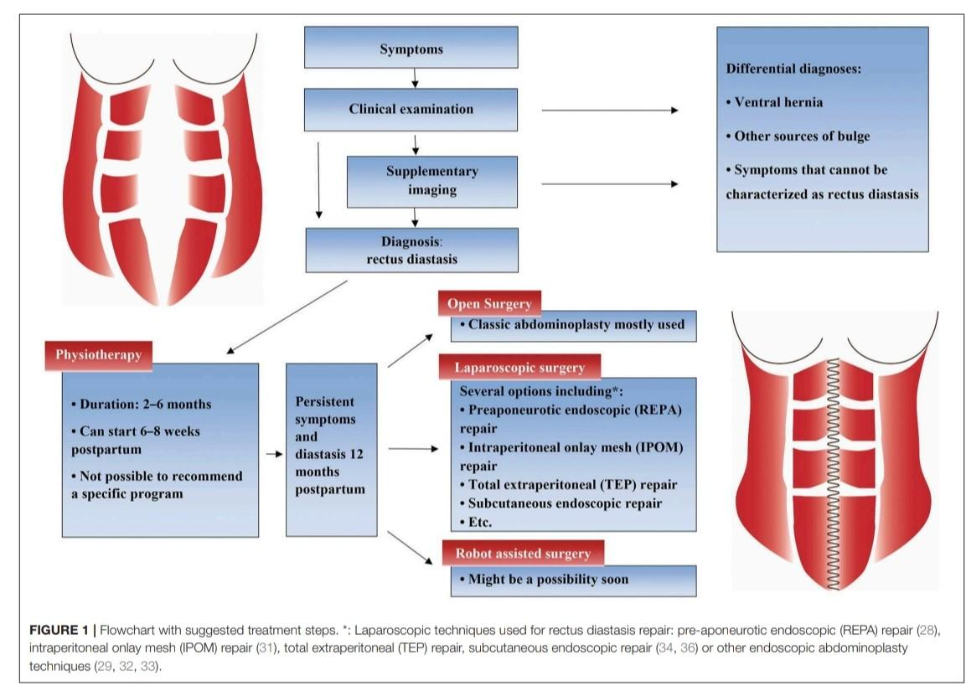

Slide 49
References
1. Brauman D (2008) Diastasis recti: clinical anatomy. Plast Reconstr Surg 122(5):1564–1569 2. Beer GM et al (2009) The normal width of the linea alba in nulliparous women. Clin Anat 22(6):706–711 3. Sperstad JB et al (2016) Diastasis recti abdominis during pregnancy and 12 months after childbirth: prevalence, risk factors and report of lumbopelvic pain. Br J Sports Med 50(17):1092–1096 4. Parker MA, Millar LA, Dugan SA (2009) Diastasis rectus abdominis and lumbo-pelvic pain and dysfunction-are they related? J Women’s Health Phys Ther 33(2):15–22 5. Emanuelsson P et al (2016) Operative correction of abdominal rectus diastasis (ARD) reduces pain and improves abdominal wall muscle strength: A randomized, prospective trial comparing retromuscular mesh repair to double-row, self-retaining sutures. Surgery 160(5):1367–1375 6. Bellido Luque J et al (2015) Totally endoscopic surgery on diastasis recti associated with midline hernias. The advantages of a minimally invasive approach. Prospective cohort study. Hernia 19(3):493–501 7. Benjamin DR, van de Water AT, Peiris CL (2014) Effects of exercise on diastasis of the rectus abdominis muscle in the antenatal and postnatal periods: a systematic review. Physiotherapy 100(1):1–8

Slide 50
8. Akram J, Matzen SH (2014) Rectus abdominis diastasis. J Plast Surg Hand Surg 48(3):163–169 9. Moher D et al (2009) Preferred reporting items for systematic reviews and meta-analyses: the PRISMA statement. PLoS Med 6(7):e1000097 10. Higgins JPT, Green S (2011) Cochrane Handbook for Systematic Reviews of Interventions. Green S (ed). Vol. Version 5.1.0.: The Cochrane Collaboration. 11. Jadad AR et al (1996) Assessing the quality of reports of randomized clinical trials: is blinding necessary? Control Clin Trials 17(1):1–12 12. Higgins JP et al (2011) The Cochrane Collaboration’s tool for assessing risk of bias in randomised trials. BMJ 343:d5928

Slide 51
Thank you

