Slide 1
Percutaneous Irreversible Electroporation in Locally Advanced and Recurrent Pancreatic Cancer (PANFIRE-2): A Multicenter, Prospective, Single-Arm, Phase II Study
-Journal club presentation
Department of general surgery
Kanyakumari government medical college
Naveen .V
1st year General Surgery PG

Slide 2
Alette H. Ruarus, MD • Laurien G. P. H. Vroomen, MD, PhD • Bart Geboers, MD • Eran van Veldhuisen, BSc • Robbert S. Puijk, MD • Sanne Nieuwenhuizen, MD • Marc G. Besselink, MD, PhD • Barbara M. Zonderhuis, MD • Geert Kazemier, MD, PhD • Tanja D. de Gruijl, MSc, PhD • Krijn P. van Lienden, MD, PhD • Jan J. J. de Vries, MD • Hester J. Scheffer, MD, PhD • Martijn R. Meijerink, MD, PhD
From the Department of Radiology and Nuclear Medicine, Cancer Center Amsterdam, De Boelelaan 1117, 1081 HV Amsterdam, the Netherlands (A.H.R., L.G.P.H.V., B.G., R.S.P., S.N., J.J.J.d.V., H.J.S., M.R.M.); Department of Surgery, Cancer Center Amsterdam, Amsterdam UMC, University of Amsterdam, the Netherlands (E.v.V., M.G.B.); Department of Surgery, Cancer Center Amsterdam, Amsterdam UMC, Vrije Universiteit Amsterdam, the Netherlands (B.M.Z., G.K.); Immunotherapy Laboratory, Cancer Center Amsterdam, Amsterdam UMC, Vrije Universiteit Amsterdam, the Netherlands (T.D.d.G.); and Department of Radiology and Nuclear Medicine, Cancer Center Amsterdam, Amsterdam UMC, University of Amsterdam, the Netherlands (K.P.v.L.). Received May 20, 2019; revision requested July 16; revision received August 23; accepted September 18

Slide 3
INTRODUCTION
Irreversible electroporation (IRE) is a primarily nonthermal ablative technique in which high-voltage electrical pulses are applied between needle electrodes inserted within and around the tumor. The pulses irreversibly damage the cellular membrane by creating nanopores, inducing programmed cell death
. Several studies confirmed the safety profile of IRE, with encouraging survival outcomes . Most studies, however, were retrospective, had limited sample sizes, and had a relatively short follow-up.
The aim of the Pancreatic Carcinoma—Safety and Feasibility Study of Irreversible Electroporation, or PANFIRE, was to critically assess the efficacy and long-term safety of percutaneous IRE for locally advanced pancreatic cancer and isolated local recurrence following surgical resection of pancreatic cancer.

Slide 4
AIM
Patients with locally advanced pancreatic cancer have a dismal prognosis, with a median overall survival (OS) of 12–14 months with systemic therapies. Irreversible electroporation (IRE), a nonthermal ablative technique, may prolong survival of patients with locally advanced pancreatic cancer.

Slide 5
MATERIALS AND METHODS
This multicenter, prospective, single-arm, phase II study consecutively included 50 study participants: 40 with locally advanced pancreatic cancer and 10 with isolated local recurrence after pancreatic tumor resection
All participants provided written informed consent. After the interim safety results of 25 participants were reported , the institutional review board approved continuation in a phase II efficacy trial on the basis of futility analysis.
The previous study dealt with the safety and short-term survival results; the current study addresses the long-term outcome after percutaneous IRE and included an additional 15 participants with locally advanced pancreatic cancer and 10 participants with postresection local recurrence.

Slide 6
Methods
Type of study : Prospective study
Inclusion Criteria : Study participants were discussed at a multidisciplinary tumor board involving experts from hepatopancreatobiliary surgery, diagnostic and interventional radiology, medical oncology, radiation oncology, interventional endoscopy, and pathology.
  Participants older than 18 years with either locally advanced pancreatic cancer (stage III) according to the American Joint Committee on Cancer criteria or isolated local recurrence with a maximum tumor diameter of 5 cm were considered eligible after pathologic confirmation.
  An American Society of Anesthesiologists score of 0–3 and adequate bone marrow and liver and renal function were required. Exclusion criteria were downstaging after radiation therapy or chemotherapy to resectability, allergy to contrast material, history of epilepsy or ventricular cardiac arrhythmias, an implanted stimulation device, and compromised liver function (eg, portal hypertension, international normalized ratio .1.5 without use of anticoagulants, ascites). Radiation therapy, immunotherapy, and/or chemotherapy had to be discontinued at least 6 weeks before IRE.

Slide 7
Exclusion criteria : were downstaging after radiation therapy or chemotherapy to resectability, allergy to contrast material, history of epilepsy or ventricular cardiac arrhythmias, an implanted stimulation device, and compromised liver function (eg, portal hypertension, international normalized ratio .1.5 without use of anticoagulants, ascites). Radiation therapy, immunotherapy, and/or chemotherapy had to be discontinued at least 6 weeks before IRE.

Slide 8
Technique - IRE Procedure
All procedures were performed by interventional radiologists Prophylactic antibiotics (cefuroxime, 1500 mg, and metronidazole, 750 mg) were administered intravenously 1 hour before the procedure.
First, a flush catheter was placed transfemorally in the proximal abdominal aorta for repeated administration of small doses of intra-arterial contrast ,80 mL, 1:1 diluted with saline) and to enable dynamic and real-time visualization of the tumor and surrounding vessels before, during, and after ablation
. All procedures were performed by using electrocardiography synchronization.

Slide 9
After induction of general anesthesia with complete muscle paralysis, abdominal contrast material–enhanced CT was performed to confirm correct tumor staging and to establish exact tumor size and shape.
The three-dimensional tumor measurements, including a 5-mm tumor-free margin, were used to determine the required number and configuration of the electrodes.
With use of real-time CT guidance, the needles were inserted according to treatment planning, aiming for an interelectrode distance of 12–24 mm and with an active tip length of 15 mm.
Then, 10 test pulses of 90 µsec and 1500 V/cm were delivered between all needle pairs, which had an interelectrode distance of 12–24 mm , to determine the delivered current.

Slide 10
Voltage settings were adjusted if the target current of 20–40 A was not reached. Subsequently, a total of 90 pulses were administered for each electrode pair.
If necessary, an electrode pullback was subsequently performed to treat the superficial part of the tumor . Directly after ablation, contrast-enhanced CT was performed to confirm complete ablation zone coverage of the tumor and to detect early complications (ie, bleeding or thrombosis).

Slide 11
FOLLOW-UP
Every 3 months, full blood examination, including pancreatic enzymes (Table E1 [online]), and thoracoabdominal contrast-enhanced CT were performed until progressive disease was detected. For instances of solitary local tumor progression, repeat treatment with IRE was considered and discussed in the tumor board.

Slide 12
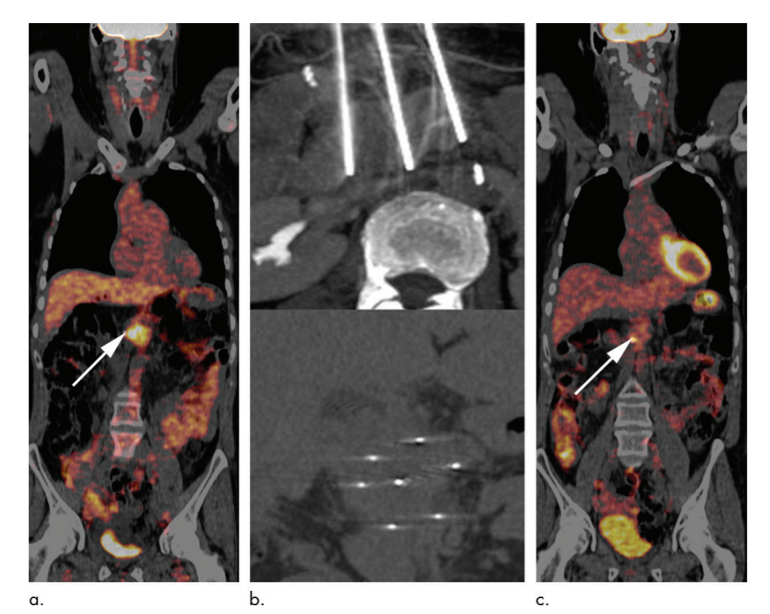

Slide 13
Statistical Analysis
Continuous variables are presented with descriptive statistics, including means, standard deviations, medians, and ranges. Categorical variables are presented as frequencies. Survival analysis was performed by using the Kaplan-Meier method.
The log-rank test was used to determine survival differences between groups.
The Cox proportional hazards method was used for univariable analysis to determine prognostic factors. P , .05 was considered to indicate a statistically significant difference. Data were analyzed with SPSS software

Slide 14
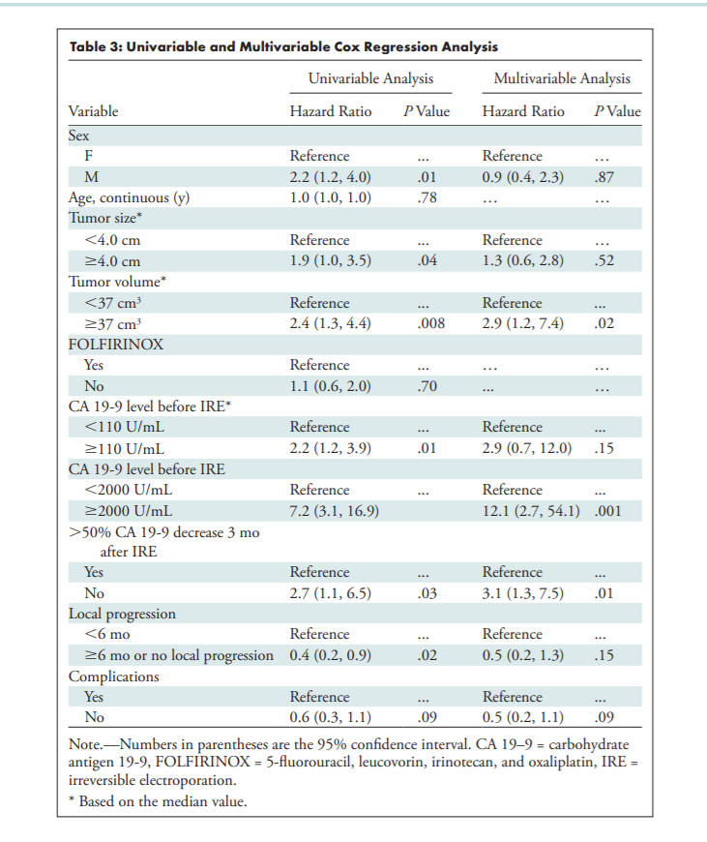

Slide 15
Results
The median OS for participants with locally advanced pancreatic cancer was 17 months from the time of diagnosis (95% confidence interval [CI]: 15 months, 19 months) and 10 months from IRE (95% CI: 8 months, 11 months).
For both participants treated without (n = 18) and with (n = 22) FOLFIRINOX before IRE, median OS from diagnosis was 17 months (95% CI: 7 months, 28 months and 15 months, 18 months, respectively; P = .26).
Median OS from IRE was 11 months (95% CI: 8 months, 13 months) for participants without FOLFIRINOX before IRE and 9 months (95% CI: 7 months, 10 months) for participants with upfront FOLFIRINOX (P = .71).
For participants with local postresection recurrence, median time from resection to isolated recurrence was 24 months (IQR, 18–40 months) and median OS was 16 months from diagnosis of recurrence (95% CI: 11 months, 22 months) and 9 months from IRE (95% CI: 2 months, 16 months

Slide 16
None of the tumors were downstaged to resection after IRE. Overall, 23 of the 50 participants (46%) showed local progression after IRE; the median local tumor progression-free survival was 10 months (95% CI: 8 months, 11 months). Five participants underwent repeat treatment

Slide 17
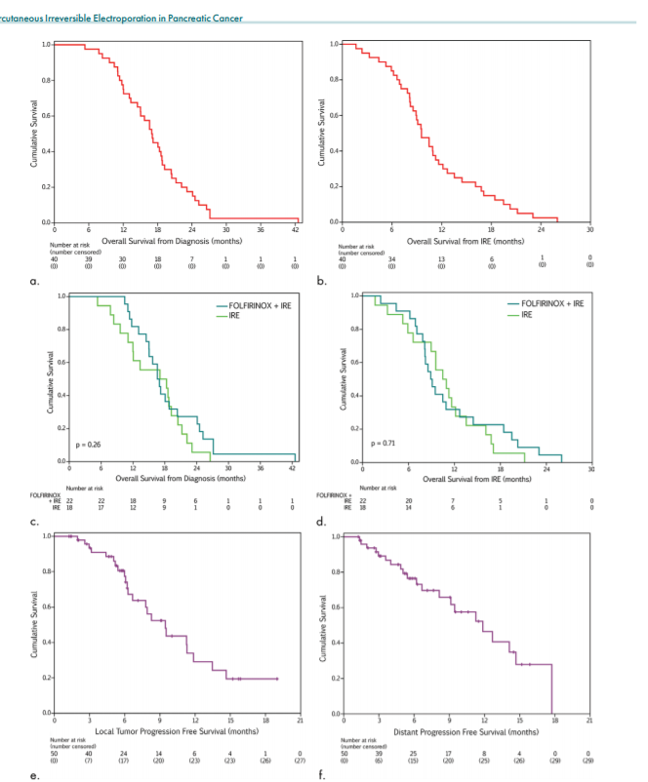
KAPLAN MEIER CURVE

Slide 18
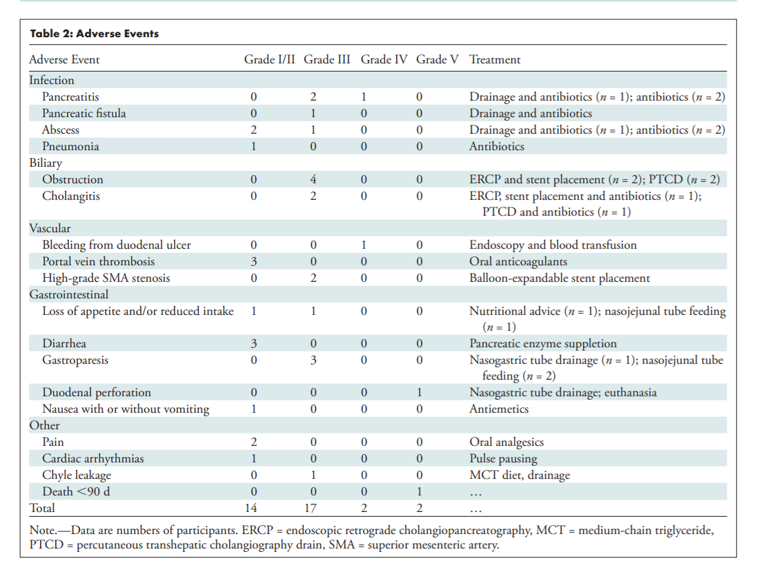

Slide 19
Limitations of Study
there is heterogeneity regarding systemic treatment regimens before and after IRE, which may have affected survival.
timing of IRE varied because the time of referral varied greatly, and no strict policy was implemented regarding pretreatment strategies and timing of IRE after these treatments.
The upper size limit of 5 cm may have introduced a confounder for the comparison of survival data to data from systemic regimens or other local treatments because a larger tumor was associated with worse survival.
Moreover, diagnostic laparoscopy was not performed routinely.

Slide 20
SEQUEL PANFIRE -3
IRE+ Nivolumab + CpG

Slide 21
References
1. Siegel RL, Miller KD, Jemal A. Cancer statistics, 2017. CA Cancer J Clin 2017;67(1):7–30. 2. Tempero MA, Malafa MP, Al-Hawary M, et al. Pancreatic adenocarcinoma, version 2.2017, NCCN Clinical Practice Guidelines in Oncology. J Natl Compr Canc Netw 2017;15(8):1028–1061. 3. Van den Broeck A, Sergeant G, Ectors N, Van Steenbergen W, Aerts R, Topal B. Patterns of recurrence after curative resection of pancreatic ductal adenocarcinoma. Eur J Surg Oncol 2009;35(6):600–604. 4. Comito T, Cozzi L, Zerbi A, et al. Clinical results of stereotactic body radiotherapy (SBRT) in the treatment of isolated local recurrence of pancreatic cancer after R0 surgery: a retrospective study. Eur J Surg Oncol 2017;43(4):735–742. 5. Huguet F, André T, Hammel P, et al. Impact of chemoradiotherapy after disease control with chemotherapy in locally advanced pancreatic adenocarcinoma in GERCOR phase II and III studies. J Clin Oncol 2007;25(3):326–331. 6. Chauffert B, Mornex F, Bonnetain F, et al. Phase III trial comparing intensive induction chemoradiotherapy (60 Gy, infusional 5-FU and intermittent cisplatin) followed by maintenance gemcitabine with gemcitabine alone for locally advanced unresectable pancreatic cancer. Definitive results of the 2000-01 FFCD/SFRO study. Ann Oncol 2008;19(9):1592–1599. 7. Loehrer PJ Sr, Feng Y, Cardenes H, et al. Gemcitabine alone versus gemcitabine plus radiotherapy in patients with locally advanced pancreatic cancer: an Eastern Cooperative Oncology Group trial. J Clin Oncol 2011;29(31):4105–4112. 8. Vincent A, Herman J, Schulick R, Hruban RH, Goggins M. Pancreatic cancer. Lancet 2011;378(9791):607–620. 9. Rombouts SJ, Walma MS, Vogel JA, et al. Systematic review of resection rates and clinical outcomes after FOLFIRINOX-based treatment in patients with locally advanced pancreatic cancer. Ann Surg Oncol 2016;23(13):4352–4360. 10. Suker M, Beumer BR, Sadot E, et al. FOLFIRINOX for locally advanced pancreatic cancer: a systematic review and patient-level meta-analysis. Lancet Oncol 2016;17(6):801–810.

Slide 22
11. Ruarus A, Vroomen L, Puijk R, Scheffer H, Meijerink M. Locally advanced pancreatic cancer: a review of local ablative therapies. Cancers (Basel) 2018;10(1): E16. 12. Rubinsky B, Onik G, Mikus P. Irreversible electroporation: a new ablation modality- -clinical implications. Technol Cancer Res Treat 2007;6(1):37–48. 13. Scheffer HJ, Vroomen LG, de Jong MC, et al. Ablation of locally advanced pancreatic cancer with percutaneous irreversible electroporation: results of the phase I/II PANFIRE Study. Radiology 2017;282(2):585–597.
14. Scheffer HJ, Melenhorst MC, Echenique AM, et al. Irreversible electroporation for colorectal liver metastases. Tech Vasc Interv Radiol 2015;18(3): 159–169. 15. Liehr UB, Wendler JJ, Blaschke S, et al. Irreversible electroporation: the new generation of local ablation techniques for renal cell carcinoma [in German]. Urologe A 2012;51(12):1728–1734. 16. Belfiore G, Belfiore MP, Reginelli A, et al. Concurrent chemotherapy alone versus irreversible electroporation followed by chemotherapy on survival in patients with locally advanced pancreatic cancer. Med Oncol 2017;34(3):38. 17. Månsson C, Brahmstaedt R, Nilsson A, Nygren P, Karlson BM. Percutaneous irreversible electroporation for treatment of locally advanced pancreatic cancer following chemotherapy or radiochemotherapy. Eur J Surg Oncol 2016;42(9):1401–1406. 18. Narayanan G, Hosein PJ, Beulaygue IC, et al. Percutaneous image-guided irreversible electroporation for the treatment of unresectable, locally advanced pancreatic adenocarcinoma. J Vasc Interv Radiol 2017;28(3):342–348. 19. Leen E, Picard J, Stebbing J, Abel M, Dhillon T, Wasan H. Percutaneous irreversible electroporation with systemic treatment for locally advanced pancreatic adenocarcinoma. J Gastrointest Oncol 2018;9(2):275–281. 20. Sugimoto K, Moriyasu F, Tsuchiya T, et al. Irreversible electroporation for nonthermal tumor ablation in patients with locally advanced pancreatic cancer: initial clinical experience in Japan. Intern Med 2018;57(22):3225–3231. 21. van Veldhuisen E, Vogel JA, Klompmaker S, et al. Added value of CA19-9 response in predicting resectability of locally advanced pancreatic cancer following induction chemotherapy. HPB 2018;20(7):605–611.

Slide 23
22. Conroy T, Desseigne F, Ychou M, et al. FOLFIRINOX versus gemcitabine for metastatic pancreatic cancer. N Engl J Med 2011;364(19):1817–1825. 23. Hashimoto K, Ueno H, Ikeda M, et al. Do recurrent and metastatic pancreatic cancer patients have the same outcomes with gemcitabine treatment? Oncology 2009;77(3-4):217–223. 24. Strobel O, Hartwig W, Hackert T, et al. Re-resection for isolated local recurrence of pancreatic cancer is feasible, safe, and associated with encouraging survival. Ann Surg Oncol 2013;20(3):964–972. 25. Kiliç M, Göçmen E, Tez M, Ertan T, Keskek M, Koç M. Value of preoperative serum CA 19-9 levels in predicting resectability for pancreatic cancer. Can J Surg 2006;49(4):241–244. 26. Halloran CM, Ghaneh P, Connor S, Sutton R, Neoptolemos JP, Raraty MG. Carbohydrate antigen 19.9 accurately selects patients for laparoscopic assessment to determine resectability of pancreatic malignancy. Br J Surg 2008;95(4):453–459. 27. Flak RV, Stender MT, Jensen TM, et al. Treatment of locally advanced pancreatic cancer with irreversible electroporation - a Danish single center study of safety and feasibility. Scand J Gastroenterol 2019;54(2):252–258.

Slide 24
Thank you.

