Slide 1
New Technique for Magnetic Compression
Anastomosis Without Incision for
Gastrointestinal Obstruction
-Journal club presentation
Department of general surgery
Kanyakumari government medical college
Dr. Naveen
2nd year Gen Surg PG

Slide 2
Teppei Kamada, MD, Hironori Ohdaira, MD, PhD, Hideyuki Takeuchi, MD, Junji Takahashi, MD, Eisaku Ito, MD, Norihiko Suzuki, MD, Satoshi Narihiro, MD, Masashi Yoshida, MD, FACS, PhD, Eigoro Yamanouchi, MD, PhD, Yutaka Suzuki, MD, PhD

Slide 3
Introduction
In magnetic compression anastomosis (MCA), 2 rareearth magnets are placed in the lumen of the organ to be anastomosed, inducing necrosis at the compression site by allowing them to adsorb. This technique can spontaneously induce anastomosis similar to that created by surgery, but with low invasiveness.
In terms of its clinical application, the procedure is expected to be an alternative to surgery in patients with serious comorbidities, complicated abdominal surgical history, or postoperative complications.

Slide 4
Aim and Objective
This retrospective study aimed to evaluate the safety, efficacy, and feasibility of MCA for gastrointestinal obstruction without requiring general anesthesia.
The primary endpoint was the technical success of MCA.
Secondary endpoints were the procedural time, duration to anastomosis formation, complications, length of hospital stay, and the number of days until the start of oral intake.

Slide 5
Methods
Type of study : retrospective single-center study
Sample Size : 14.
Inclusion Criteria : Eligible for inclusion were adult patients with gastrointestinal obstruction or stenosis requiring any small or large bowel anastomosis to restore bowel continuity, with severe comorbidities, complicated abdominal surgical history, or postoperative complications, and who were unable to tolerate surgery.

Slide 6
Pre-treatment evaluation
Patients underwent gastrointestinal series and enhanced computed tomography (e-CT) to confirm the absence of interposition of other organs between the anastomotic sites and to calculate the length of the stenosis and the distance between the magnets.

Slide 7
Technique
With the patient in the supine position, the procedure was performed under constant fluoroscopic guidance, with 0.4 mg of flunitrazepam administered intravenously by a team of 2 surgeons and 1 radiologist.
To deliver the parent magnet, the stenosis, if present, was temporarily dilated with a wire-guided balloon catheter and an endoscope or ileus tube was allowed to pass.
Then, a 0.045- to 0.049-inch guidewire was inserted, through which the magnet was delivered
The guidewire was bent to approximately 30 degrees, 10 cm from the tip, so that the magnet would not be dislodged spontaneously by peristalsis

Slide 8
Technique
After confirming that the magnets had been adsorbed at the target position, the endoscope and catheter were removed and the procedure was completed.

Slide 9
Magnets used
Samarium cobalt magnets were used. The magnets placed at the oral and anal sides of the intestinal tract were referred to as “daughter” and “parent magnets,” respectively.
These magnets were 10 to 25 mm in diameter and 5 mm thick.
They were disc-shaped magnets at 1,800 to 3,500 gauss.
The magnets were chosen depending on the diameters of the intestine and stenosis .

Slide 10
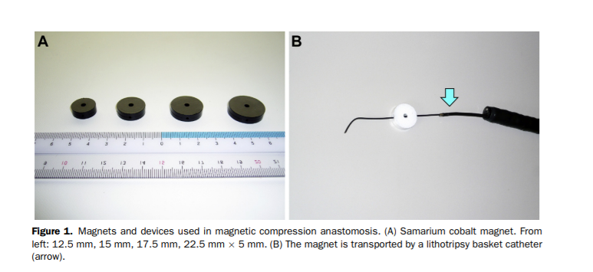

Slide 11
Postoperative management
The position of the magnet was checked daily with plain abdominal radiography. Completion of the anastomoses was identified by the change in the position of the magnets.
The magnets were spontaneously passed through the anus; if excretion of the magnets was slow, the magnets were retrieved endoscopically.
After the magnets were retrieved, the anastomosis was observed using endoscopy within a few days.

Slide 12
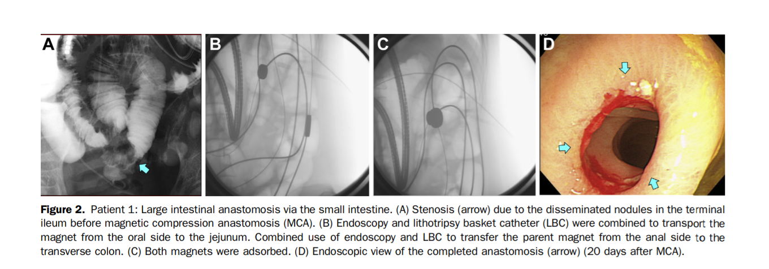

Slide 13
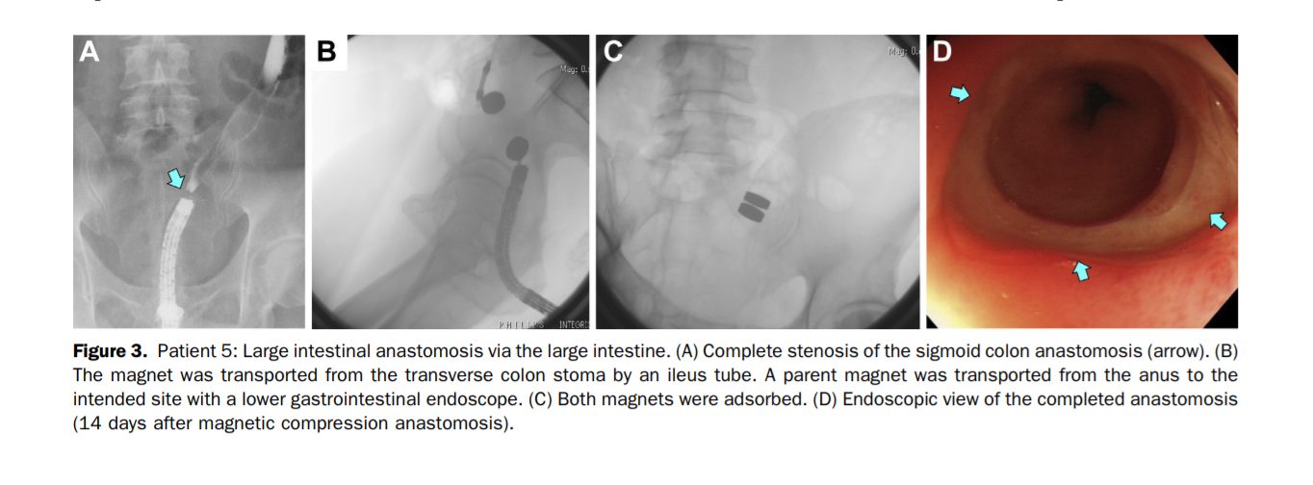

Slide 14
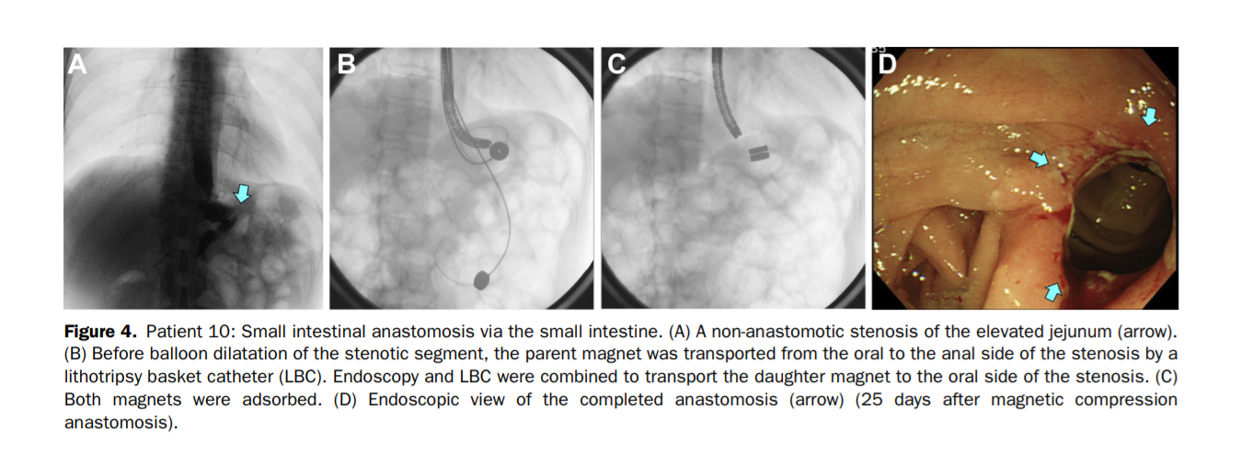

Slide 15
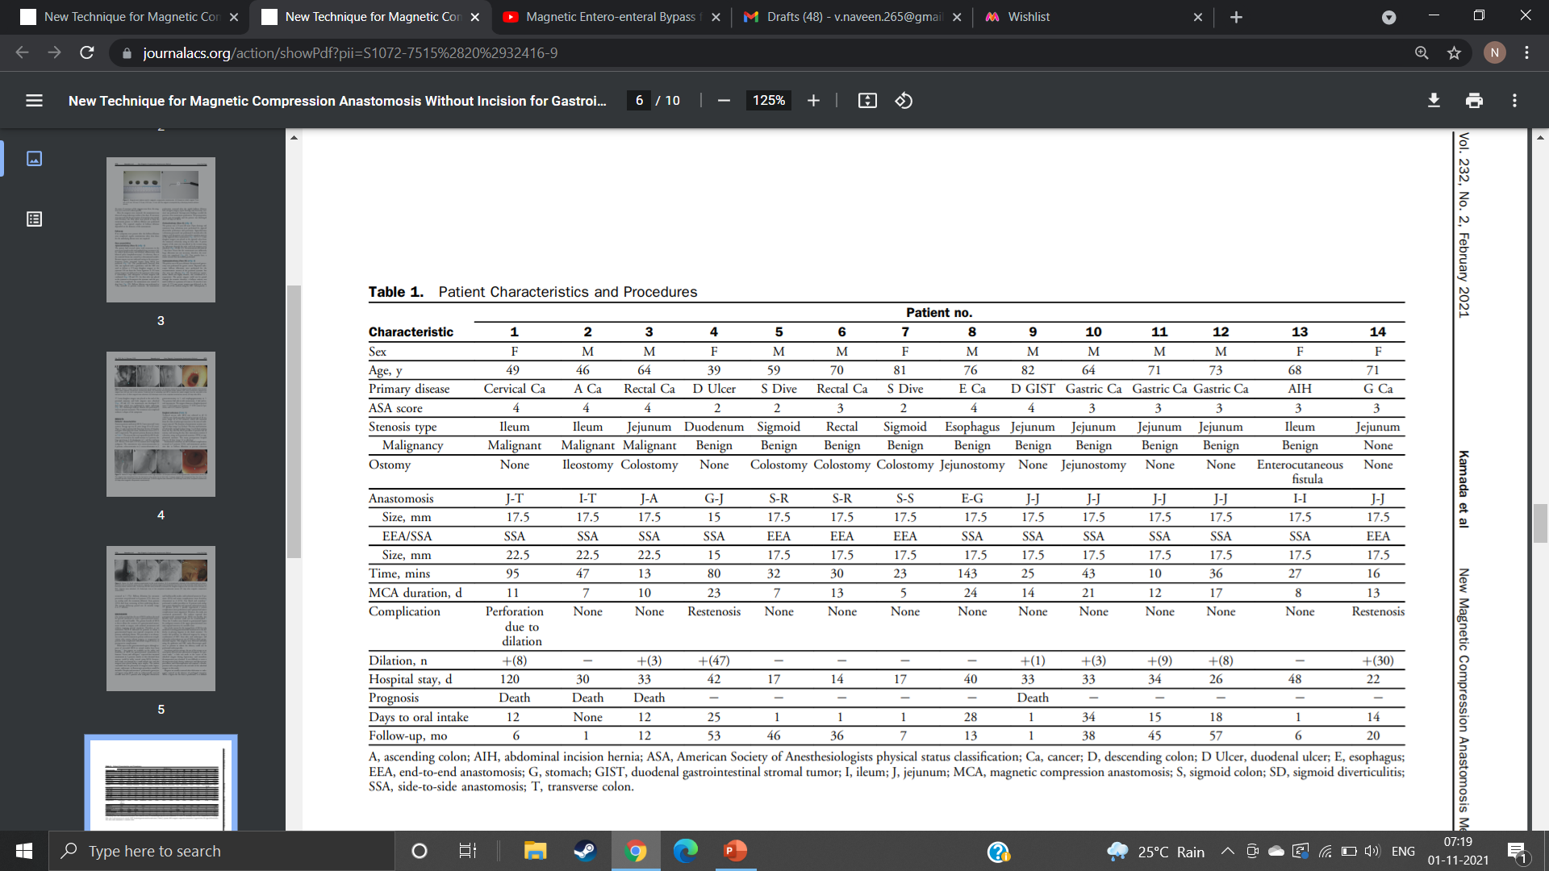

Slide 16
Results - Patients’ characteristics
Fourteen patients underwent MCA; 9 were men and 5 were women. Average age was 65 years (range 39 to 82 years).
Three, 6, and 5 patients had American Society of Anesthesiologists (ASA) physical status classification scores of 2, 3, and 4, respectively.
The stenosis that was responsible for MCA indications was located in the small intestine in 9 patients, the large intestine in 3, the duodenum in 1, and the esophagus in 1.
Eleven (73%) and 3 (27%) stenoses were benign and malignant.
The anastomoses were enteroenterostomies in 6 patients, colorectostomies in 3, enterocolostomies in 3, gastroenterostomy in 1, and esophagogastrostomy in 1.

Slide 17
Ten patients had side-to-side anastomosis; 4 had end-toend anastomosis.
The magnet diameters (daughter/parent) were 17.5/17.5 mm in 11 patients, 17.5/22.5 mm in 2 patients, and 15/15 mm in 1 patient.

Slide 18
RESULTS - Surgical outcomes
Technical success with MCA was achieved in all 14 (100%) cases. Each procedure lasted an average of 44 minutes (range 10 to 143 minutes).
The duration of anastomosis creation averaged 13 days (range 5 to 24 days).
The time until initiation of oral intake averaged 13 days (range 1 to 34 days) starting from the day after the MCA procedure if patients had an ostomy, and starting the day after anastomosis creation if otherwise, using total parenteral nutrition (TPN) as supplemental nutrition.
The mean postoperative hospital stay was 36 days (range 14 to 120 days).

Slide 19
Anastomotic restenosis, an MCA-related complication, occurred in 2 patients (14%), and anastomotic perforation due to balloon dilatation to prevent restenosis occurred in 1 (7%).
Balloon dilatation for restenosis prevention was performed in 8 patients (57%; there was an overlap with the treatment dilation).
Four patients (29%) died from worsening of their underlying disease.
The average follow-up period was 34 months (range 6 to 57 months).

Slide 20
Disadvantages
the difficulty in placing magnets in the distal intestine.
Other complications, such as anastomotic leakage, injury to other organs, and perforation due to long-term magnet placement, were not observed.
in the absence of a supplemental nutritional pathway, it is a challenge to force parenteral nutrition until the anastomosis is completed.
MRI is contraindicated because a magnet is present in the body

Slide 21
Conclusion
MCA without general anesthesia can be a valuable alternative to surgery for gastrointestinal obstruction.

Slide 22
References
1. Yamanouchi E, Kumano R, Kobayashi K, et al. Treatment for bowel or biliary obstruction by magnetic compression anastomosis development of Yamanouchi’s method and its clinical evaluation. J Nippon Med Sch 2002;69:471e475. 176 Kamada et al New Magnetic Compression Anastomosis Method J Am Coll Surg 2. Zaritzky M, Ben R, Zylberg GI, Yampolsky B. Magnetic compression anastomosis as a nonsurgical treatment for esophageal atresia. Pediatr Radiol 2009;39:945e949. 3. Dorman RM, Vali K, Harmon CM, et al. Repair of esophageal atresia with proximal fistula using endoscopic magnetic compression anastomosis (magnamosis) after staged lengthening. Pediatr Surg Int 2016;32:525e528. 4. Ersoz G, Tekin F, Bozkaya H, et al. Magnetic compression anastomosis for patients with a disconnected bile duct after living-donor related liver transplantation: a pilot study. Endoscopy 2016;48:652e656. 5. Parlak E, Koksal AS, Kucukay F, et al. A novel technique for the endoscopic treatment of complete biliary anastomosis obstructions after liver transplantation: through-the-scope magnetic compression anastomosis. Gastrointest Endosc 2017;85:841e847. 6. Muraoka N, Uematsu H, Yamanouchi E, et al. Yamanouchi magnetic compression anastomosis for bilioenteric anastomotic stricture after living-donor liver transplantation. J Vasc Interv Radiol 2005;16:1263e1267. 7. Pichakron KO, Jelin EB, Hirose S, et al. Magnamosis II: magnetic compression anastomosis for minimally invasive gastrojejunostomy and jejunojejunostomy. J Am Coll Surg 2011;212: 42e49. 8. Wall J, Diana M, Leroy J, et al. MAGNAMOSIS IV: magnetic compression anastomosis for minimally invasive colorectal surgery. Endoscopy 2013;45:643e648. 9. Jamshidi R, Stephenson JT, Clay JG, et al. Magnamosis: magnetic compression anastomosis with comparison to suture and staple techniques. J Pediatr Surg 2009;44:222e228.

Slide 23
References
10. Gonzales KD, Douglas G, Pichakron KO, et al. Magnamosis III: delivery of a magnetic compression anastomosis device using minimally invasive endoscopic techniques. J Pediatr Surg 2012;47:1291e1295. 11. An Y, Zhang Y, Liu H, et al. Gastrojejunal anastomosis in rats using the magnetic compression technique. Sci Rep 2018;8:11620. 12. Zhao G, Ma J, Yan X, et al. Optimized force range of magnetic compression anastomosis in dog intestinal tissue. J Pediatr Surg 2019;54:2166e2171. 13. Diana M, Wall J, Perretta S, et al. Totally endoscopic magnetic enteral bypass by external guided rendez-vous technique. Surg Innov 2011;18:317e320. 14. Graves CE, Co C, Hsi RS, et al. Magnetic compression anastomosis (magnamosis): first-in-human trial. J Am Coll Surg 2017;225:676e681.e1. 15. Chopita N, Vaillaverde A, Cope C, et al. Endoscopic gastroenteric anastomosis using magnets. Endoscopy 2005;37:313e317. 16. van Hooft JE, Vleggaar FP, Le Moine O, et al. Endoscopic magnetic gastroenteric anastomosis for palliation of malignant gastric outlet obstruction: a prospective multicenter study. Gastrointest Endosc 2010;72:530e535. 17. Kawabata H, Sone D, Yamaguchi K, et al. Endoscopic gastrojejunostomy for superior mesenteric artery syndrome using magnetic compression anastomosis. Gastroenterology Res 2019;12:320e323. 18. Lebares CC, Graves CE, Lin MY, et al. Endoscopic magnetic compression anastomosis for small bowel bypass in a high operative risk setting. Surg Laparosc Endosc Percutan Tech 2019;29:e84ee87.

Slide 24
Thank you.

