Slide 1
Lateral dorsal infundibular approach: an alternative option for the safe completion of difficult laparoscopic cholecystectomy
HOD-Prof Dr.J.A.Jayalal, M.S.,FRCS.,Ph.D
Chief- Dr. Nagalekshmi M.S., D.G.O
Assistant Professor
Dr. Geolin Mithun M.S
Dr. Ram Praveen M.S Review by Dr.B.Vignesh
First year Postgraduate
Department of General Surgery

Slide 2
Author details
Department of Hepatobiliary Surgery,
The 925Th Hospital of the Chinese Institute of Hepatobiliary
Surgery, First Affiliated Hospital, Army Military Medical University, Shapingba
District, Galtonian Main Street 29, Chongqing 400038, China.

Slide 3
Aim of study
The main aim of this study is in cases of Acute cholecystitis to avoid
Bile duct injury by using laparoscopic subtotal cholecystectomy
technique to explore and mark the infundibulum to determine the
initial anatomical landmarks, from the lateral submucosal approach to
the dorsal, until complete circumferential dissection of the
infundibulum allows Critical view of safety, and the Gall bladder can
then be removed in sections.

Slide 4
Methods
Type of study: Retrospective single centre study
Sample size : 469
Duration of study : July 2016 to June 2021

Slide 5
INCLUSION CRITERIA
The patients who met a Tokyo Guidelines 2018 criteria for the
diagnosis of Acute cholecystitis and performed the lateral dorsal
infundibular approach were included in the analysis.
EXCLUSION CRITERIA
Patients with Gallbladder cancer confirmed by post operative HPE.

Slide 6
Technique

Slide 8
Critical view of safety
Hepatocystic triangle dissection to identify the cystic duct and cytic artery
Dissection of GB from cystic plate
Only two structures entering the GB – cystic duct and cystic artery

Slide 10
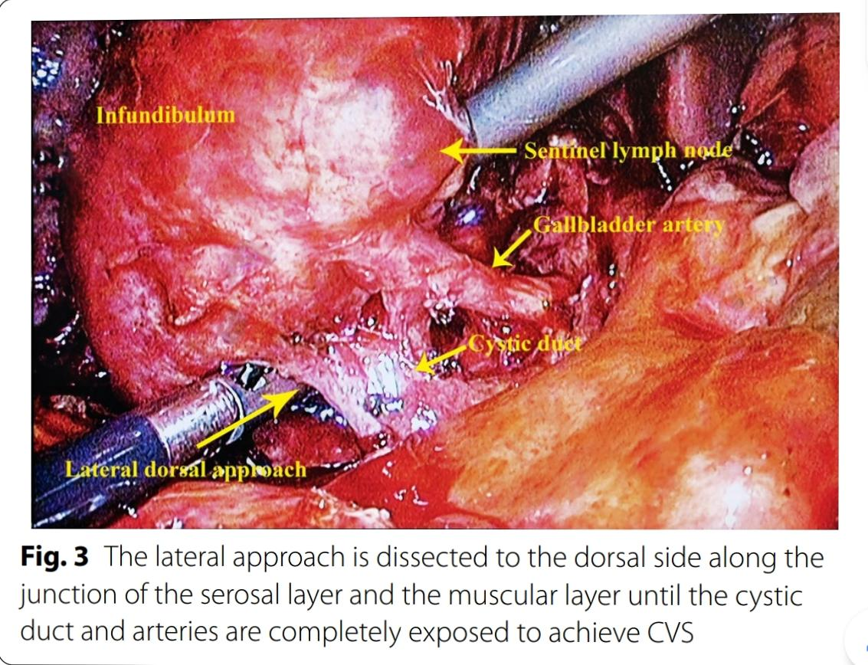

Slide 11
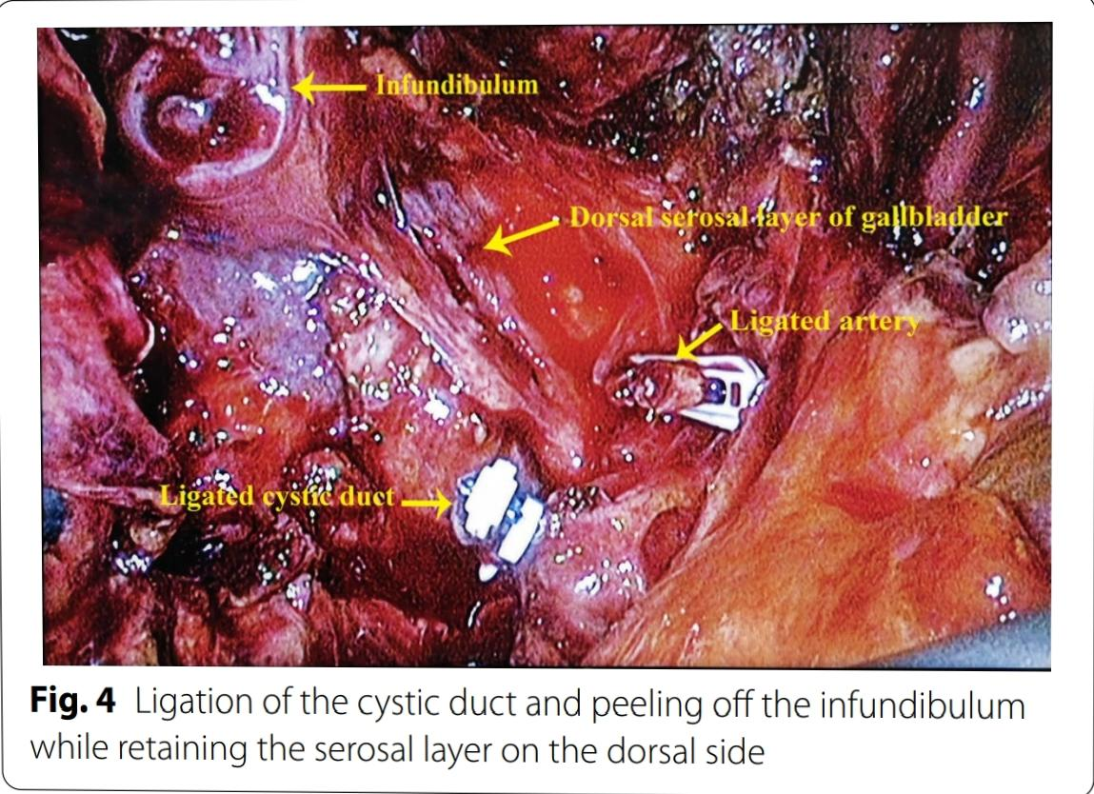
At this point, the dissection of the infundibulum is complete. To avoid Bile duct injury, the cystic duct can be dissected according to the actual situation. Once the Critical view of safety is reached, the confluence of the infundibulum and the cystic duct is ligated using clips.

Slide 12
Results
Total sample 469
Male - 176
Female - 293
Mean age - 55.1 years
Patients with anomalies in cystic duct and hepatic duct found preoperatively using MRCP – 64
Elective surgery- 438
Emergency surgery – 31
Patient requiring conversion - 10

Slide 13
RESULTS
The described technique was completed successfully in 439 patients i.e 92.5% of total sample size
Fenestrating subtotal cholecystectomy : 13 (2.1%)
Reconstituting subtotal cholecystectomy : 22(4.7%)
Postoperative bile leaks: 4 patients(0.9%)
3 in fenestrating and 1 in reconstituting of which except one case all healed spontaneously with ERCPwithin 1 to2 weeks
Remaining one case took two months to heal spontaneously due to non refusal for ERCP by the patient.
No retained stones

Slide 14
RESULTS
Mean operation time 117.0 minutes +/- 34.5 mind
Mean blood loss : 146.9+/- 53.2 ml
Mean duration of hospital stay : 7.6 +/- 2 days

Slide 15
Conclusion
Minimally invasive surgery has great benefits and is extremely attractive to patients and surgeons; however acute cholecystitis presents a challenge for surgeons carrying out Laparoscopic cholecystectomy.
During difficult Laparoscopic cholecystectomy, CVS can gradually achieved by changing the surgical approach and safely peeling of the infundibulum first to achieve cholecystectomy.

Slide 16
Limitations
Single center study
Retrospective study
Small sample size

Slide 17
References
1. Umezawa Kamarajah SK, Karri S, Bundred JR, Evans RPT, Lin A, Kew T, Ekeozor C,
Powell SL, Singh P, Grifths EA. Perioperative outcomes after laparoscopic
cholecystectomy in elderly patients: a systematic review and meta-analy-
sis. Surg Endosc. 2020;34(11):4727–40.
2. NIH Consensus conference. Gallstones and laparoscopic cholecystec-
tomy. JAMA. 1993;269(8):1018–24.
3. Wakabayashi G, Iwashita Y, Hibi T, Takada T, Strasberg SM, Asbun HJ, Endo
I, Umezawa A, Asai K, Suzuki K, et al. Tokyo Guidelines 2018: surgical
management of acute cholecystitis: safe steps in laparoscopic cholecys-
tectomy for acute cholecystitis (with videos). J Hepatobiliary Pancreat Sci.
2018;25(1):73–86.
4. Yamashita Y, Takada T, Strasberg SM, Pitt HA, Gouma DJ, Garden
OJ, Buchler MW, Gomi H, Dervenis C, Windsor JA, et al. TG13 surgi-
cal management of acute cholecystitis. J Hepatobiliary Pancreat Sci.
2013;20(1):89–96.
5. Brunt LM, Deziel DJ, Telem DA, Strasberg SM, Aggarwal R, Asbun H, Bonjer
J, McDonald M, Alseidi A, Ujiki M et al. Safe cholecystectomy multi-
society practice guideline and state of the art consensus conference on
prevention of bile duct injury during cholecystectomy. Ann Surg 2020,
272(1):3–23.
6. Strasberg SM, Pucci MJ, Brunt LM, Deziel DJ. Subtotal Cholecystectomy-
"Fenestrating" vs “Reconstituting” subtypes and the prevention of bile
duct injury: defnition of the optimal procedure in difcult operative
conditions. J Am Coll Surg. 2016;222(1):89–96.

Slide 18
13. Strasberg SM, Hertl M, Soper NJ. An analysis of the problem of
biliary injury during laparoscopic cholecystectomy. J Am Coll Surg.
1995;180(1):101–25.
14. Boerma D, Rauws EA, Keulemans YC, Bergman JJ, Obertop H, Huibregtse
K, Gouma DJ. Impaired quality of life 5 years after bile duct injury dur-
ing laparoscopic cholecystectomy: a prospective analysis. Ann Surg.
2001;234(6):750–7.
15. Booij KAC, de Reuver PR, van Dieren S, van Delden OM, Rauws EA, Busch
OR, van Gulik TM, Gouma DJ. Long-term impact of bile duct injury on
morbidity, mortality, quality of life, and work related limitations. Ann Surg.
2018;268(1):143–50.
16. Cirocchi R, Panata L, Grifths EA, Tebala GD, Lancia M, Fedeli P, Lauro
A, Anania G, Avenia S, Di Saverio S, et al. Injuries during laparoscopic
cholecystectomy: a scoping review of the claims and civil action judge-
ments. J Clin Med. 2021;10:22.
17. Kohga A, Suzuki K, Okumura T, Yamashita K, Isogaki J, Kawabe A, Kimura T.
Does preoperative MRCP imaging predict risk for conversion to subtotal
cholecystectomy in patients with acute cholecystitis? Surg Endosc.
2021;35(12):6717–23.
18. Tonolini M, Ravelli A, Villa C, Bianco R. Urgent MRI with MR cholangio-
pancreatography (MRCP) of acute cholecystitis and related complica-
tions: diagnostic role and spectrum of imaging fndings. Emerg Radiol.
2012;19(4):341–8.

Slide 19
Thank you ….

